Slide 1

ADT Impact on Cardiovascular Health
Jehonathan Pinthus, MD, PhD
McMaster University
Hamilton, ON, Canada

Slide 2
Pertinent Questions
Is ADT promoting CVD?
Why ADT may promote CVD?
What can we do about it?

Slide 3
PC Patients are at High Risk of CVD
Risk of MI, stroke, or CV death in PC patients >2% per year^{1, 2}
Risk of MI, stroke, or CV death in PC patients on ADT >4% per year^{1, 2}
CVD risk considered high if global risk estimate for hard CVD events of ≥2% per year³
Keating, et al. JNCI 2010; 102: 39
O’Farrell, et al. JCO 2015; 102: 39
Greenland et al. 2010 American Heart Association Guideline for Assessment of Cardiovascular Risk in Asymptomatic Adults. Circulation 2010; 122: e584

Slide 4
ADT is Associated With an Increased Risk of CVD in Observational Studies
Zhao, et al. PLoS One 2014; 9: e107516

Slide 5
Randomized Trials of ADT vs. Control: CV Mortality
Nguyen, et al. JAMA 306: 2359.

Slide 6
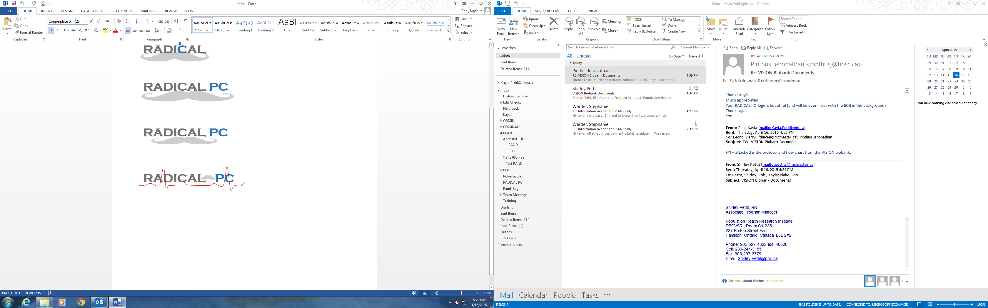
The Role of Androgen Deprivation Therapy in CArdiovascular Disease – A Longitudinal Prostate Cancer Study (RADICAL PC1)
A RAndomizeD Intervention for Cardiovascular And Lifestyle Risk Factors in Prostate Cancer Patients (RADICAL PC2)

Slide 7
Baseline Cancer Characteristics
Characteristic | New PC; no ADT N=497 | ADT N=140 | P-value
Metastatic PC, % | 5% | 15% | <0.0001
Radical prostatectomy, % | 26% | 16% | 0.013
Radiotherapy, % | 13% | 20% | 0.039

Slide 8
Baseline CV Characteristics
Characteristic | New PC; no ADT N=497 | ADT N=140 | P-value
Tobacco use, % Never Former Current | 47% 43% 10% | 34% 57% 9% | 0.013
Diabetes, % | 15% | 24% | 0.021
Coronary disease, % | 12% | 25% | 0.001
Cerebrovascular disease, % | 6% | 5% | 1.0
Statin, % | 42% | 55% | 0.008
Total cholesterol, mmol/L | 4.5±1.1 | 4.4±1.3 | 0.65
LDL cholesterol, mmol/L | 2.5±0.95 | 2.4±1.2 | 0.36
Antiplatelet/anticoagulant, % | 33% | 45% | 0.012
Systolic BP, mmHg | 138±18 | 138±20 | 0.65
Diastolic BP, mmHg | 82±12 | 81±12 | 0.15
Unrecognized HT, % | 22% | 21% | 0.91
Age, years | 67±8.0 | 72±8.8 | <0.0001

Slide 9


Is ADT Promoting CVD?
Higher baseline CVD
More prevalent CVS prevention
PC patient with no ADT
PC patient commencing on ADT

Slide 10
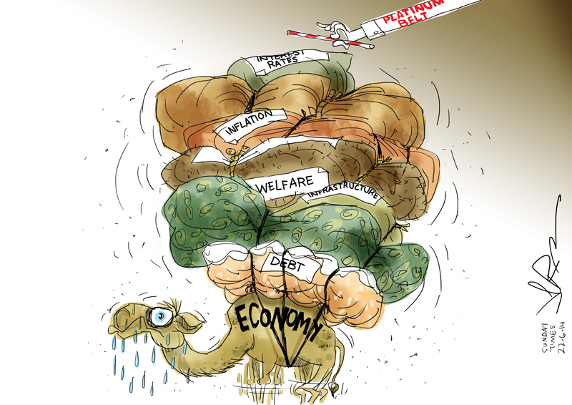

Slide 11
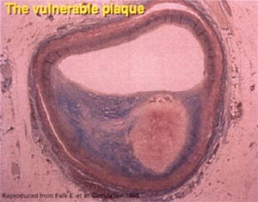
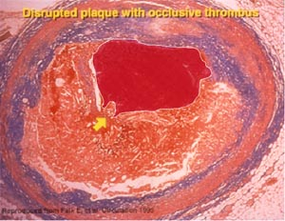
How Might ADT Accelerate CVD?
CVS (atherosclerosis) risk factors
Dysglycemia
Central adiposity
Dyslipidemia
Changes in life style
Testosterone
FSH
Plaque
vulnerability
Cardiovascular event
FSH
Testosterone

Slide 12
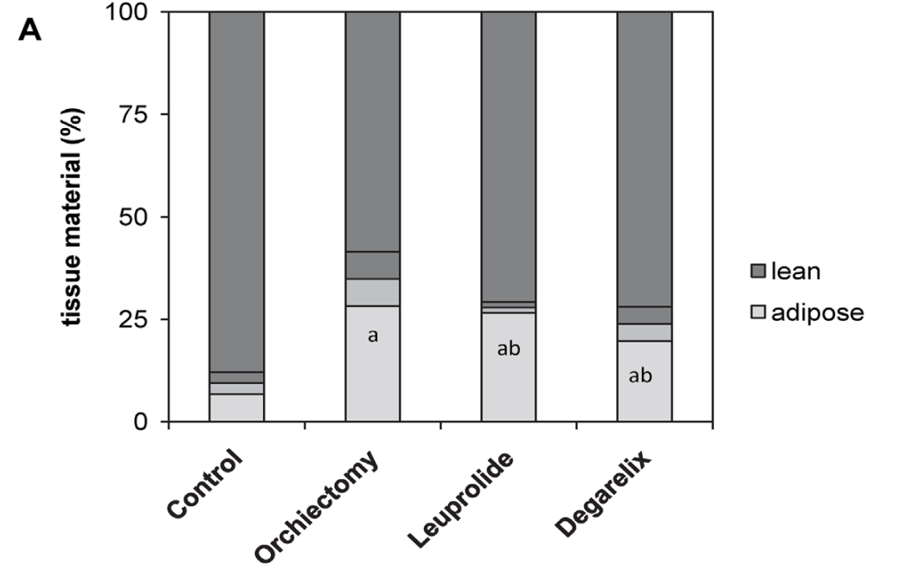
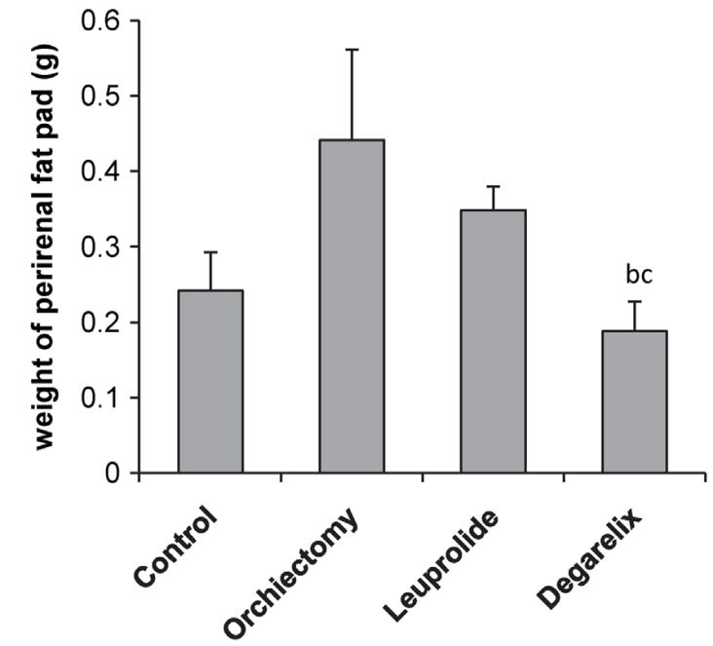
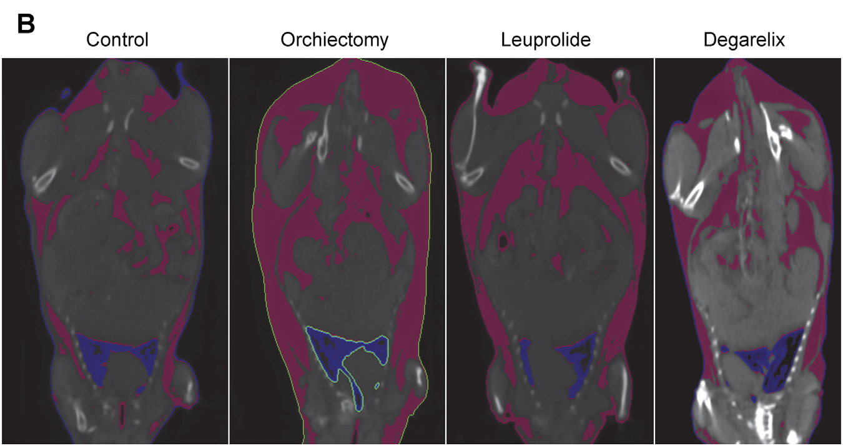
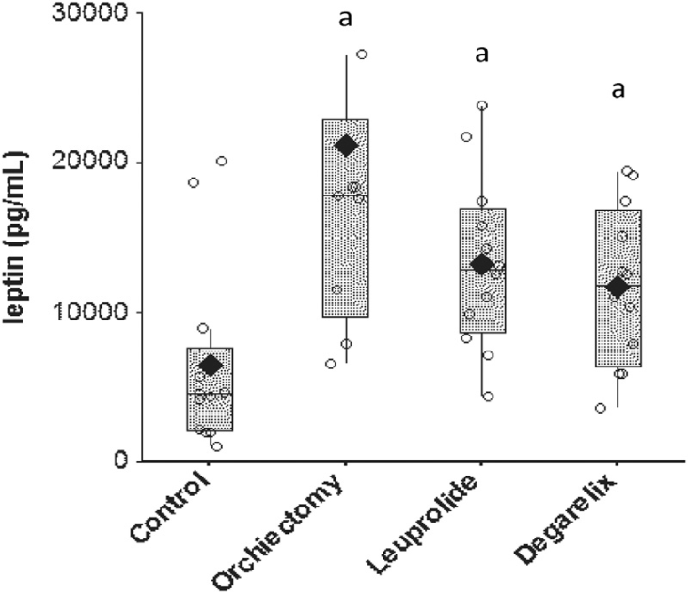
ADT Induced Obesity
N = 6 per group
Hopmans SN, et al. Urol Oncol 2014;32:1126–34

Slide 13
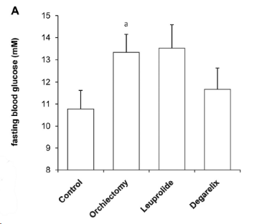
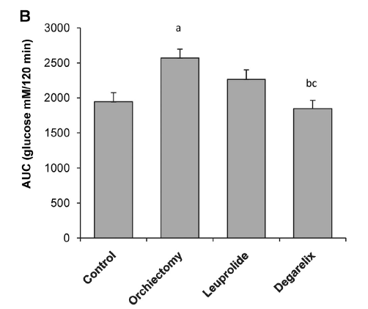
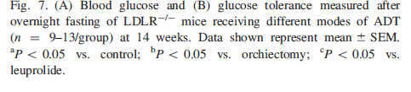
ADT Induced Glucose Intolerance
Hopmans SN, et al. Urol Oncol 2014;32:1126–34

Slide 14
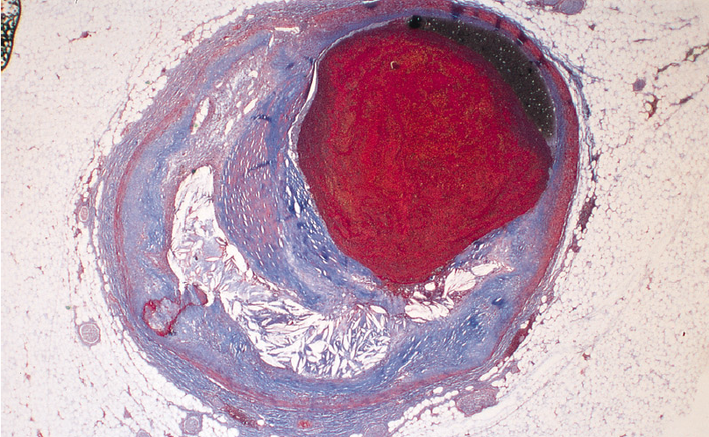
Most Acute CVD Events are Caused by Rupture of a Vulnerable Atherosclerotic Plaque

Slide 15
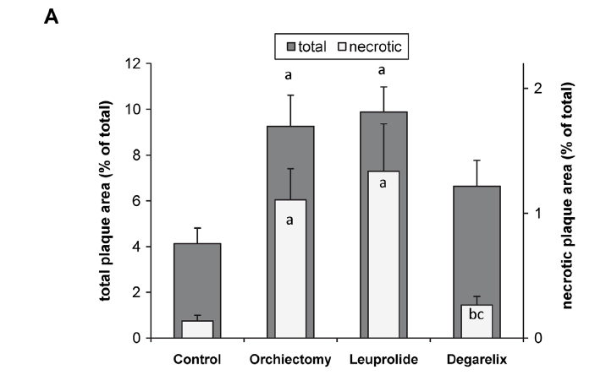
ADT Induced (De-Novo) Atherosclerosis
Hopmans SN, et al. Urol Oncol 2014;32:1126–34

Slide 16
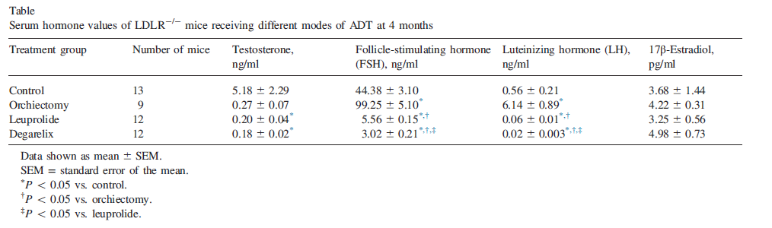
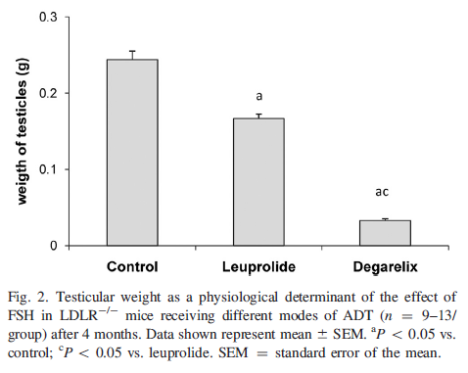
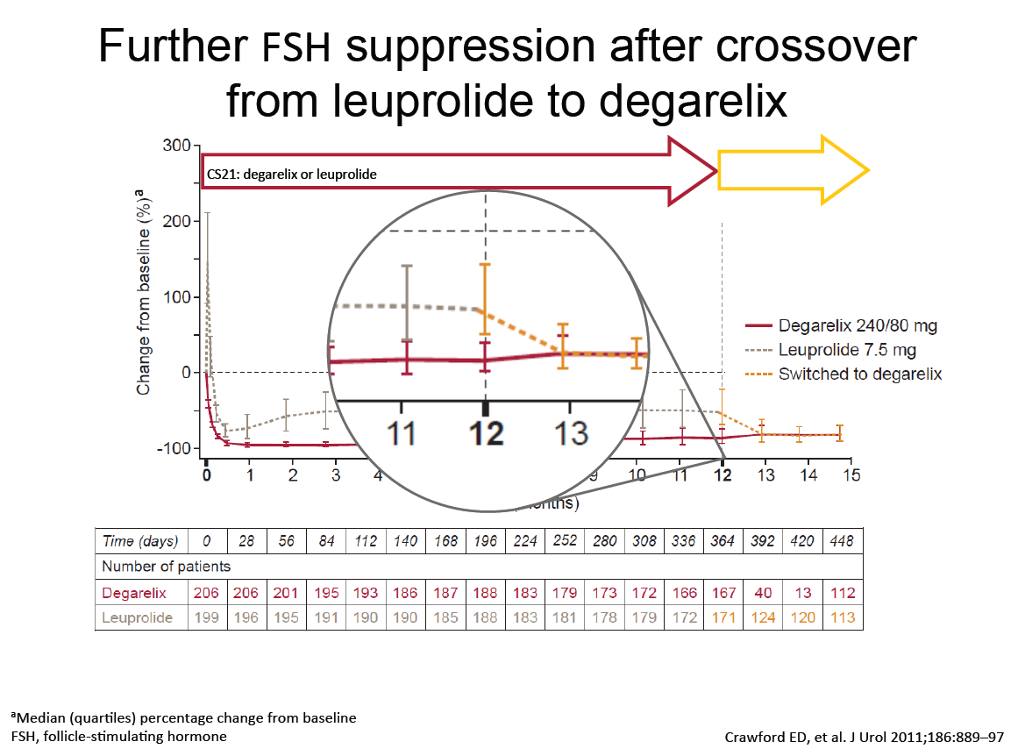
Suppression of Serum FSH and its Physiological Activity is Significantly Better With GnRH Antagonists Than Agonists

Slide 17
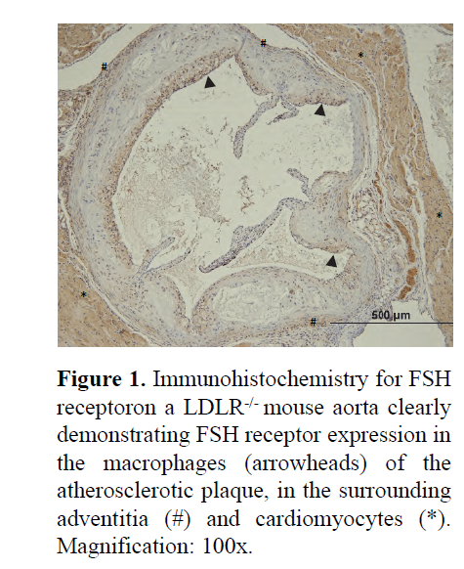
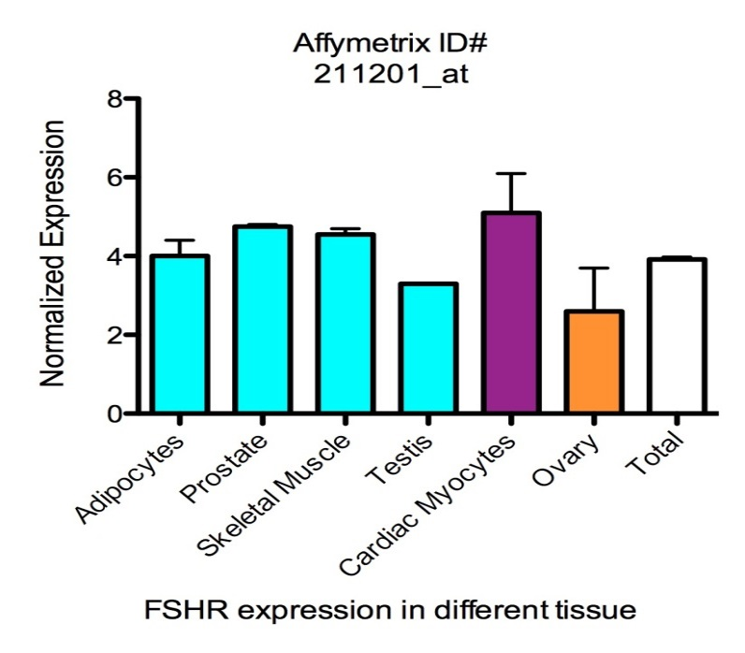
FSHR Expression
Normalized expression
Adipocytes
Prostate
Skeletal muscle
Testis
Ovary
Total
Cardiac myocytes
FSHR expression in different tissue
1. Data source: www.biogps.org
2. Tivesten A, Pinthus J et al. Submitted 2014

Slide 18
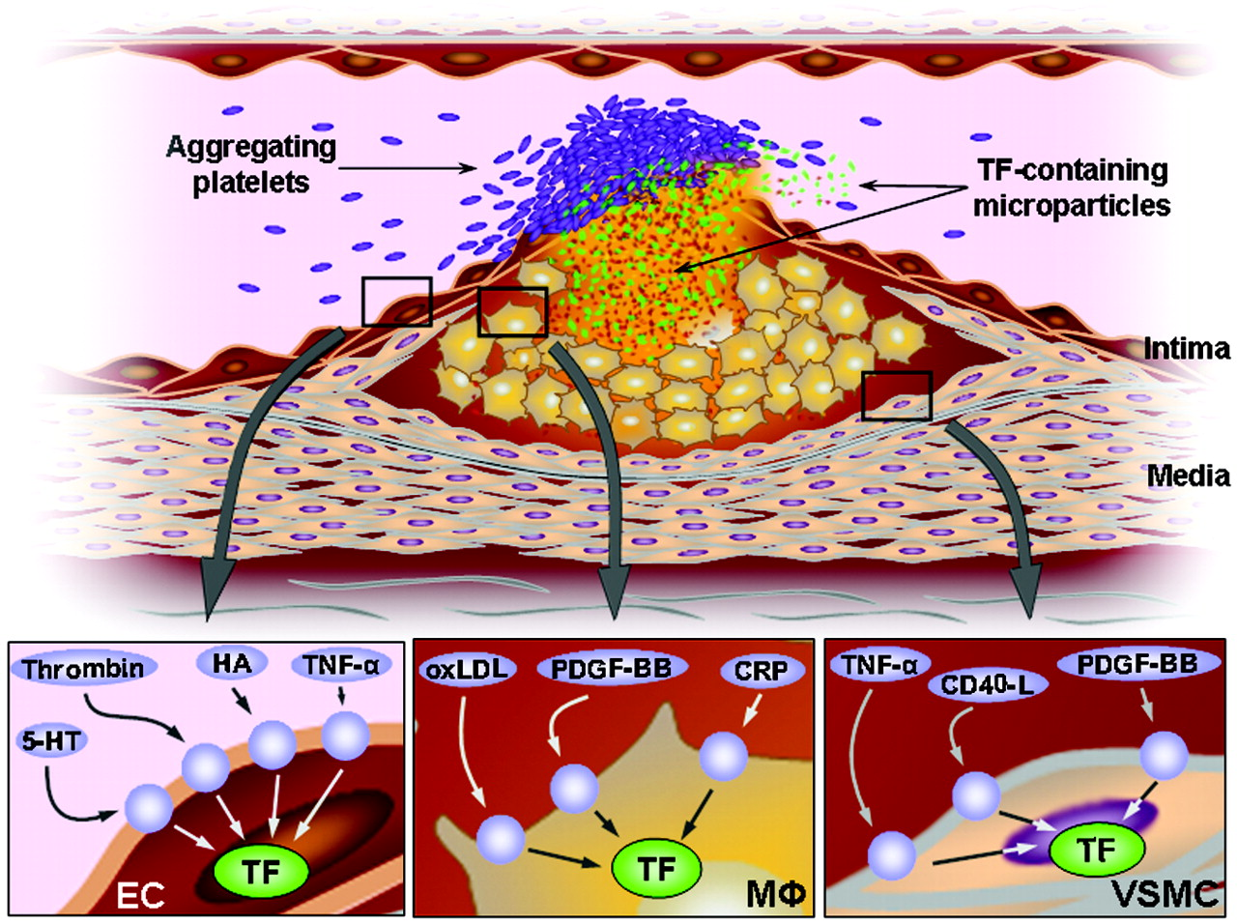



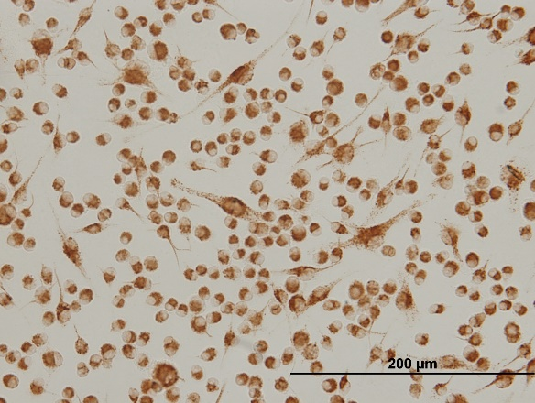
Foam Cells Play a Significant Role in Plaque Progression and Instability
conA-induced
control
Control
(charcoal-stripped FBS)
93 kDa
LHR
75 kDa
FSHR
Jan Steffel et al. Circulation. 2006;113:722-731
42 kDa
actin
Mac3-ICC
24h 100 ng/ml FSH

Slide 19
Clinical Data
Retrospective post-hoc analysis

Slide 20
Pooled Analysis: Treatment Groups
2328
Patients
1491
Degarelix
837
GnRH agonist
463 (31%)
245 (29%)
458
Goserelin
379
Leuprolide
CVD, cardiovascular disease
Albertson PC, et al. Eur Urol 2014:65;565-73

Slide 21
Selected Baseline Demographics Relating to CV Risk
Variable | Degarelix N=1491 | GnRH Agonist N=837
Age (yrs) | 71.7 | 71.6
Body Mass Index >30, n (%) | 27.2 334 (22) | 27.5 200 (24)
History of CVD, n (%) | 463 (31) | 245 (29)
History of Smoking, n (%) | 707 (47) | 432 (52)
History of Alcohol Use, n (%) | 889 (60) | 475(57)
History of Hypertension, n (%) | 1117 (75) | 615 (74)
Serum Cholesterol >6.2 mmol/L n (%) | 399 (270 | 247 (30)
Statin Medication Use, n (%) | 400 (27) | 234 (28)
History of Diabetes, n (%) | 221 (15) | 128 (15)
CVD, cardiovascular disease
Albertson PC, et al. Eur Urol 2014:65;565-73

Slide 22
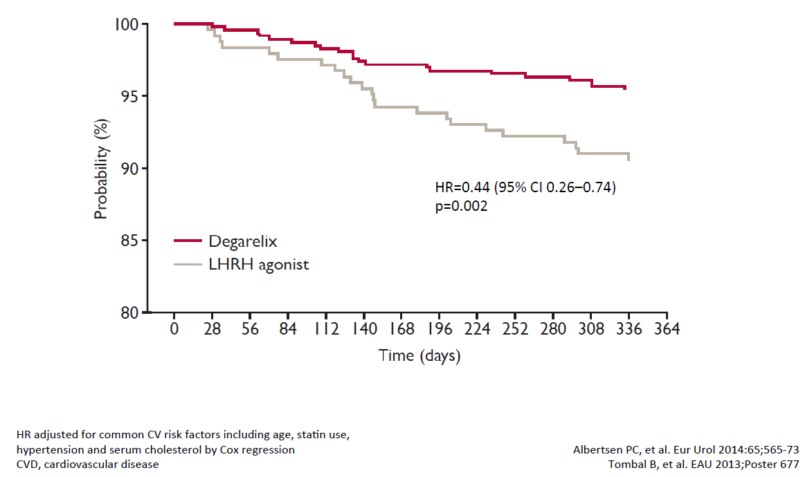
Lower Risk of CV Event or Death with Degarelix in Men With Baseline CVD

Slide 23
Clinical data
Pilot prospective randomized trial
AUA 2017 annual meeting Abstract # 17-3358

Slide 24
Abstract # 17-3358 (PI- Prof. David Margel)
Sixty-six patients with pre-existing CVD were randomized (33 antagonist vs.33 agonist).
A Cardiovascular event was considered one of the following: myocardial infarction, ischaemic or haemorrhagic cerebrovascular event, arterial embolic and thrombotic events, emergency room visit or hospitalization due to ischaemic heart disease, coronary artery or iliofemoral artery revascularization, peripheral vascular disease (vascular surgery/intervention).
Median follow up of 8.5 months

Slide 25
Table 6: Cardio-Vascular Related Events During Intervention Period (Median Follow-up 8.5 months):
 | LHRH Agonist (n=33) | LHRH Antagonist (n=33)
CVA | 1 | -
TIA | 2 | -
Unstable Agina | 4 | 2
MI | 1 | -
Other CV-related | 2 | -
Total | 30% (10) | 6% (2)
Table 7: Nature of Cardio-Vascular Events Urgency
 | LHRH Agonist (n=33) | LHRH Antagonist (n=33)
Emergency Hospitalization | 70% (7) | 100% (2)
Cardiac Outcome Managed Electively | 30% (3) | -

Slide 26
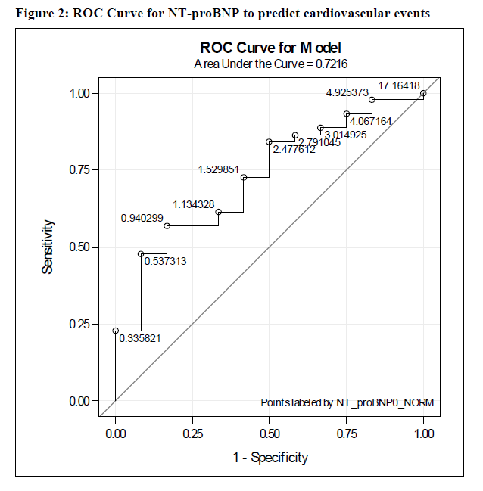
Those Were Real Events…

Slide 27
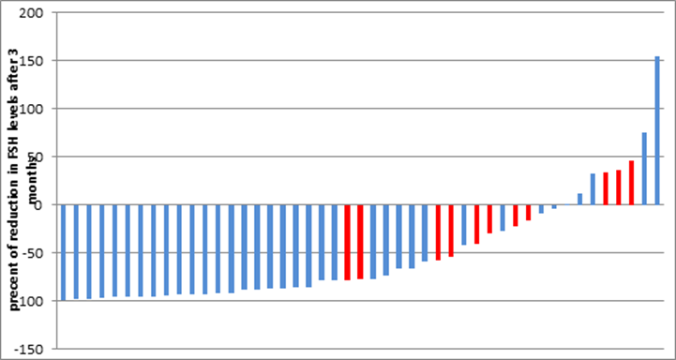
No event
Event
47% of patients who had a decrease of <60% in serum FSH levels within 3m had a CV event versus 7% of patients experiencing a >60% decreased in δ FSH in 3m (p=0.0014)
Within the agonist arm, patients with a lower than 40% FSH decrease were twice as likely to experience a cardiovascular event (28% vs. 57%).

Slide 28
Prostate cancer patients needing ADT have higher baseline cardiovascular disease characteristics and risk factors.
The question therefore may be not as much as whether ADT promotes CVD, but rather how to prevent it in this patient population?
GnRH antagonists? Other FSH inhibitors?
and/or
2. Routine Primary/secondary CVD prevention ?

Slide 29
Treatment Strategies for CVD Primary Prevention
Non-Drug | Drug
Diet Exercise Non-smoking | Aspirin Cholesterol Statin 3. Blood pressure ACE-I or ARB

Slide 30
RADICAL PC2 - Objectives
PRIMARY:
To determine whether systematic CV and lifestyle risk factor modification strategy reduces the risk of CVD in men with a new diagnosis of PC or who are commencing ADT

Slide 31
New prostate cancer (diagnosed within 1 year) or commencing ADT for the 1st time
N=6000
RADICAL PC1
Observational registry
N=1884
RADICAL PC2
Randomized, controlled trial
N=4116
Intervention:
Systematic CV risk factor management
N=2058
Control:
Usual care
N=2058
Clinical outcomes (N=6000) at average 3 years’ follow-up

Slide 32
Intervention in RADICAL PC2
Randomized in an open manner to STANDARD CARE, or
INTERVENTION, which consists of a systematic risk factor management approach:
    Aspirin
    Statin
    ACE-I for BP >130/80
    Dietary counseling
    Exercise advice
    Support to quit smoking

Slide 33
Outcomes
Composite primary efficacy outcome:
  Cardiovascular death
  Myocardial infarction
  Stroke
  Heart failure
  Arterial revascularization

Slide 34
In 2017 the Appropriate Questions Are:
Does systematic CV and lifestyle risk factor modification strategy reduces the risk of CVD in PC patients treated with ADT ?
With systematic CV and lifestyle risk factor modification strategy is there a CVS safety benefit for a specific ADT modality?

Slide 35
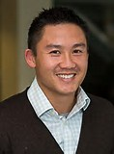
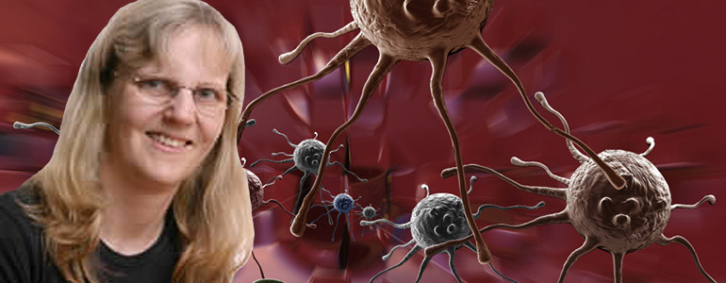


Special Thanks to:
Darryl Leong MD, PhD
Helga Duivenvoorden, PhD
David Margel MD, PhD

