Slide 1
Other Side Effects: Perception vs. Evidence
Neal D. Shore, MD
Atlantic Urology Clinic, LLC
Myrtle Beach, SC

Slide 2
Common Adverse Effects of Androgen Deprivation Therapy
Hot flashes
Loss of libido/ED
Fatigue
Anemia
Muscle loss
Gynecomastia
Obesity/Sarcopenia
Diabetes
Cardiovascular disease
Osteoporosis/fracture
Psychological: depression, memory difficulties, emotional liability

Slide 3
Testosterone: Target Organs
brain
libido, mood, cognition
skin
hair growth, balding, sebum production
heart
cardiovascular health
liver
protein synthesis
muscle
strength, volume, energy
reduction in visceral fat
male sexual organs
penile growth
spermatogenesis, erection
prostate growth and function
kidney
stimulation of erythropoietin
production
bone
strength and density
bone marrow
stimulation of stem cells

Slide 4
Androgen Deprivation Therapy
“Androgen Deprivation Syndrome”
“Androgen Withdrawal Syndrome”
“LHRH Syndrome”
“Medical Andropause”
Constellation of symptoms and conditions
ADT now used more in non-metastatic prostate cancer, exposing men to ADT for longer periods
Concerns growing over ADT side effects
Arch Intern Med. 2006;166:465-471; Oncologist. 2003;8:474-487

Slide 5
ADT Causes a Variety of Specific Adverse Effects
Central nervous system
Fatigue
Musculoskeletal system
Osteoporosis/fractures
Obesity
Sarcopenia
Hematologic system
Anemia
Endocrine
Vasomotor flushing
Lipid alterations
Insulin resistance
Reproductive system
Decreased libido
Erectile dysfunction

Slide 6
ADT has been Associated with Metabolic Changes
Metabolic syndrome is a disorder of energy utilisation and storage, diagnosed by co-occurrence of any 3 of:
Abdominal (central) obesity
Elevated blood pressure
Elevated fasting plasma glucose
High serum triglycerides
Low high-density (HDL) cholesterol levels
Metabolic syndrome increases the risk of developing CVD
ADT leads to:
Insulin resistance
Accumulation of subcutaneous fat and decreased lean body mass
Increased glucose levels
Abnormalities in lipid levels
Kelly DM, Jones TH. J Endocrinol 2013;217:R25-45

Slide 7
Metabolic Syndrome and Metabolic Changes Induced by ADT are Different
Metabolic syndrome | Metabolic changes with ADT
Increased triglycerides | Increased triglycerides
Increased visceral fat | Increased subcutaneous fat
Reduced HDL | Increased HDL
Hypertension | Hypertension
Increased fasting glucose | Increased fasting glucose
Decreased adiponectin | Increased adiponectin
Increased C-reactive protein | Normal C-reactive protein

Slide 8
Abdominal Obesity and Sarcopenia During ADT
Eugonadal young man
Saylor and Smith. J Urol. 2009;181:1998-2008

Slide 9
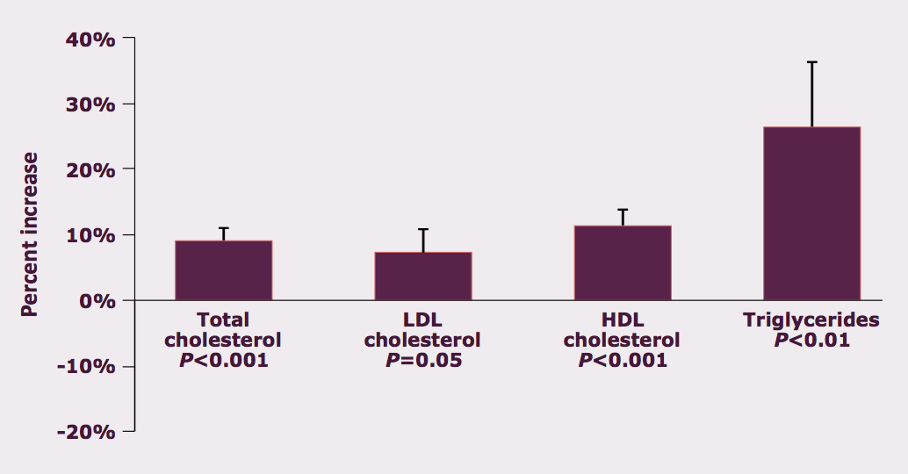
GnRH Agonists Significantly Increase Serum Lipids in Men with CaP
Smith MR et al. J Clin Endocrinol Metab. 2002;87:599-603.

Slide 10
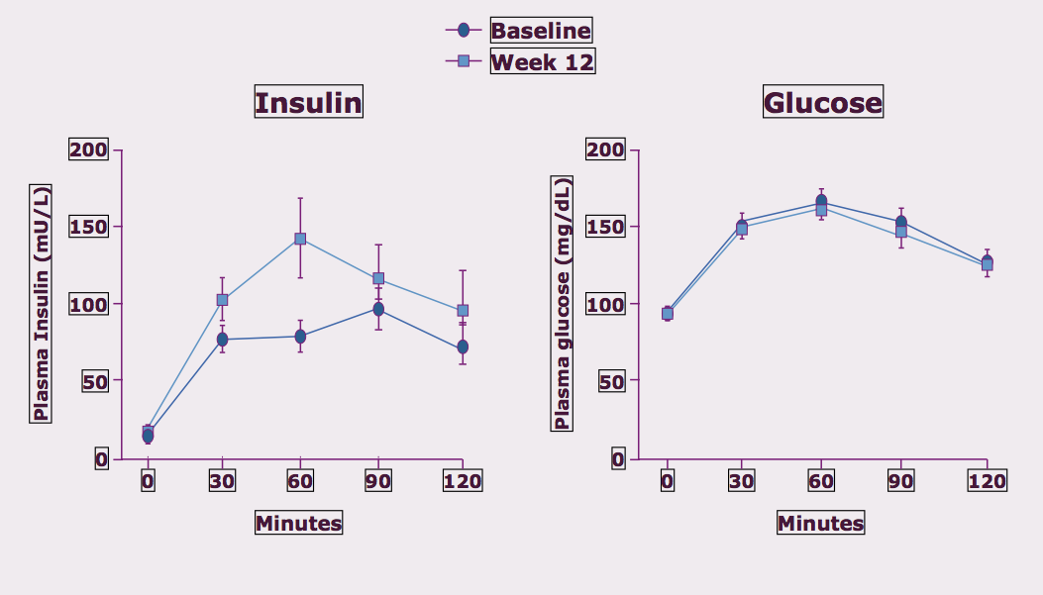
GnRH Agonists Decrease Insulin Sensitivity in Nondiabetic Men with PCa
Smith MR et al (2006) J Clin Endocrinol Metab 91:1305-8

Slide 11
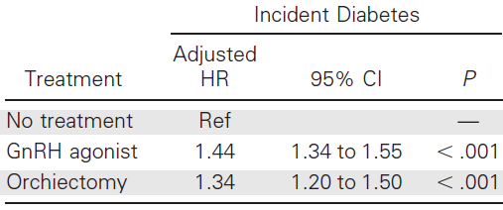
ADT and Diabetes: Consistency Between Forms of ADT
Keating, O’Malley, and Smith (2006) J Clin Oncol 24(27): 4448-56

Slide 12
ADT and Diabetes:
Consistency Between Population-Based Studies
 | Hazard Ratio | Confidence Intervals
SEER-Medicare (n= 73,196; 7055 events) | 1.44 | (1.34-1.55)
Ontario registry (n= 39,418; 2573 events) | 1.24 | (1.11-1.21)
Veterans Administration (n= 37,433, 4967 events) | 1.28 | (1.19-1.38)
References: Keating et al (2006) JCO; Alibhai et al (2009) JCO; Keating et al (2010) JNCI

Slide 13
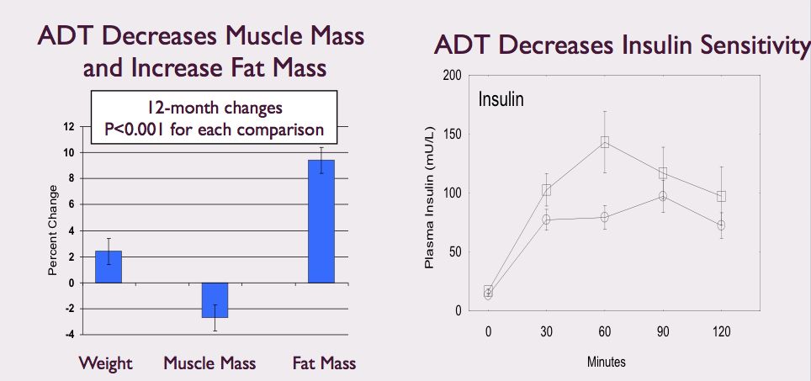
Causal Association Between ADT and Diabetes is Plausible
Smith MR et al (2002) JCEM 87:599-603
Smith MR et al (2006) JCEM 91:1305-8

Slide 14
Practical Recommendations: Diabetes
Screening
Consider testing in all men treated with ADT at baseline and yearly thereafter while receiving ADT
Recommended test: glycated hemoglobin (HbA1c)
Prediabetes=HbA1c 6.5-7.0%; diabetes=HbA1c >7%
Management of pre-diabetes
Treat other CHD risk factors
Repeat testing at least yearly
Lifestyle interventions (with follow-up counseling):
5–10% weight loss
≥150 min/week of moderate physical activity
Saylor PJ et al. J Gen Intern Med. 2009;24 Suppl 2:S389-S394.

Slide 15
Other Recommendations based on RCT
Fatigue
Aerobic and resistance exercise
Gynecomastia
RT and tamoxifen both reduce gynecomastia compared with observation, but tamoxifen reduces it more
Sexual dysfunction
- Intermittent ADT and Aerobic and resistance exercise
Nguyen PL Eur Urol. 2014 Aug 2. [Epub ahead of print].

Slide 16
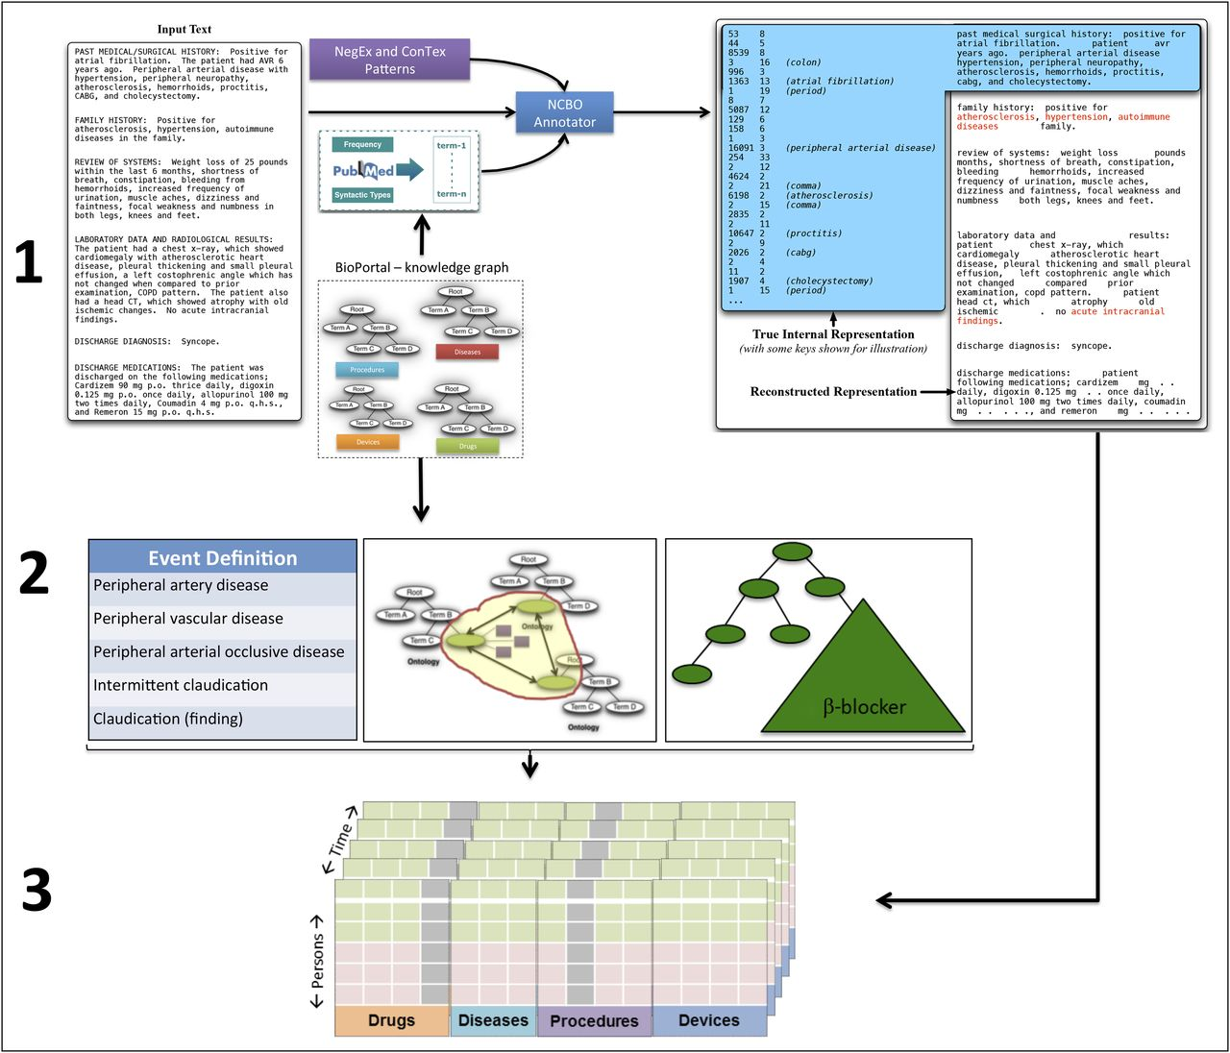
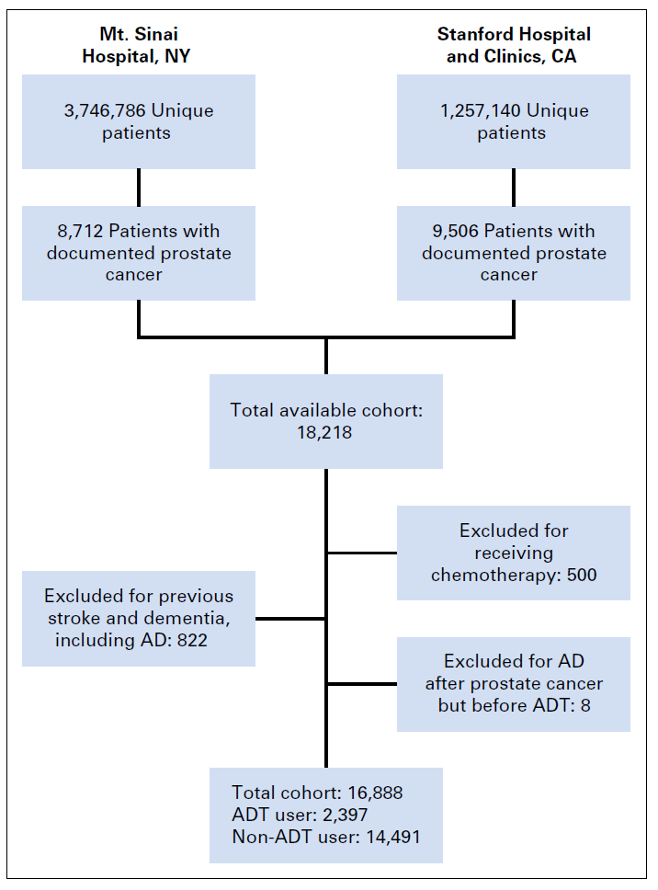
Analyses based on 125 new diagnoses
of Alzheimer’s disease
Nead et al. JCO 2016;34:566-571

Slide 17
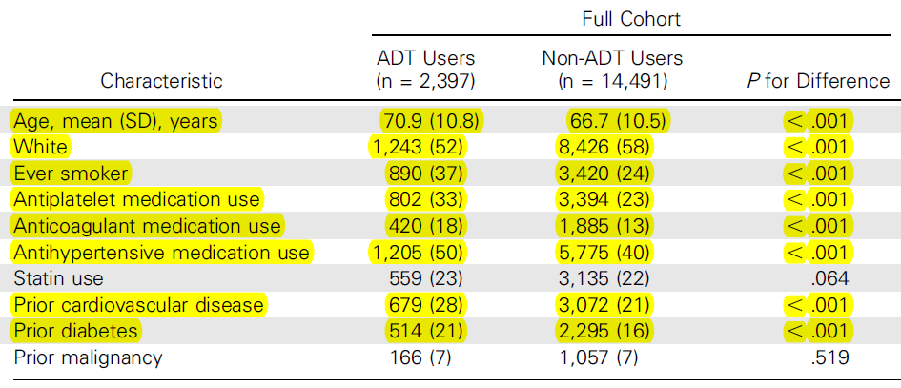
ADT and Alzheimer’s Disease
ADT Users and Non-ADT Users were dramatically different at baseline
Kevin T. Nead et al. JCO 2016;34:566-571

Slide 18
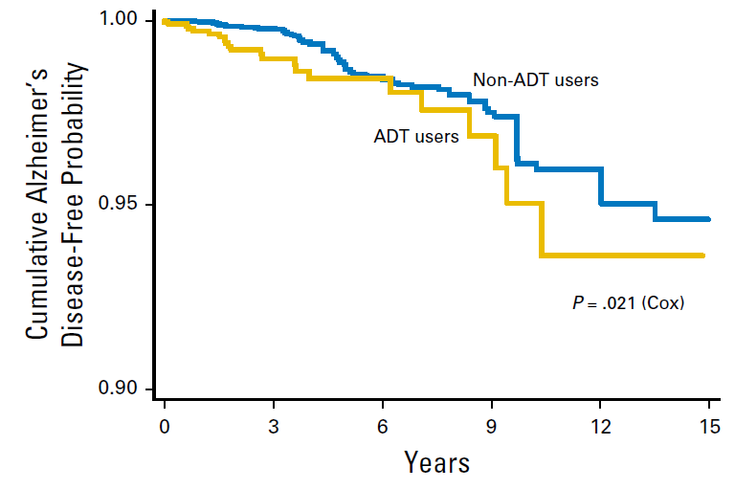
ADT and Alzheimer’s Disease
Kevin T. Nead et al. JCO 2016;34:566-571

Slide 19
Lack of specificity suggests NO causal link
between ADT and dementia

Slide 20
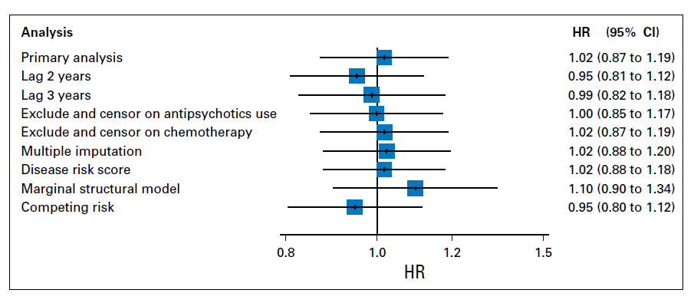

Slide 22
Why Intermittent Androgen Deprivation?
Androgen Deprivation Therapy (ADT) is associated with adverse events:
Short-term: hot flushes, loss of libido, ED, fatigue
Long-term: bone demineralization, anemia, muscle wasting, metabolic syndrome, depression
development of hormone resistance
Intermittent Androgen Deprivation (IAD) therapy aims to:
Minimize adverse events
Maximize quality of life (QoL)
Delay development hormone resistant prostate cancer (HRPC)
Reduction of non-oncologic morbidity/mortality and cost of care
Tunn U. BJU Int 2007;99 (Suppl 1):19-22; Boccon-Gibod L et al. BJU Int 2007;100:738-43
Gleave M et al Urol Oncol 2009,27:81-86
Holzbeierlein JM Urol Clin NA 2006,33:181-90; Spry NA et al BJUI (2009) Epub; Gomella, et al Urology. 2009 May;73:S28-35

Slide 23
Conclusions
ADT causes specific harms
Hot flashes, fatigue, anemia, sexual dysfunction, sarcopenia, obesity, osteoporosis, and greater risks for fractures and diabetes
Not all harms associated with ADT are causal
Cardiovascular disease, dementia, colorectal cancer, others
When considering harms linked ADT, consider strength, consistency, and biological plausibility of the association

Slide 24
Thank you!

