Slide 1
Next Generation Imaging
E. David Crawford, MD
University of Colorado, Anschutz Medical Campus

Slide 2
OUTLINE
Review of RADAR I and RADAR II
RADAR III: Rationale
RADAR III: Introduction and Methods
Methods to evaluate and review of NGI Modalities
Novel PET radiotracers and NGI tracers
PET CT
Clinical impact and case study
Recommendations of the RADAR IIII Group

Slide 4
RADAR I: REVIEW
Initiated in 2012
Working Group formed to examine unmet need: diagnosing metastatic
disease with appropriate imaging and timing
Guidelines developed on how/when to image patients
Prior imaging guidelines were unclear
Overall Goal: How to guide therapies and imaging in M1 CRPC
patients
Crawford D., Stone N., Yu E., et al. Challenges and Recommendations for Early Identification of Metastatic Disease in Prostate Cancer. Urology. 2014; Jan 8
Notes:
Before RADAR, when assessing bone metastasis, radionuclide bone scanning alone was considered the standard of care, despite the fact that other scanning modalities not listed may have provided a more accurate early assessment.

Slide 5
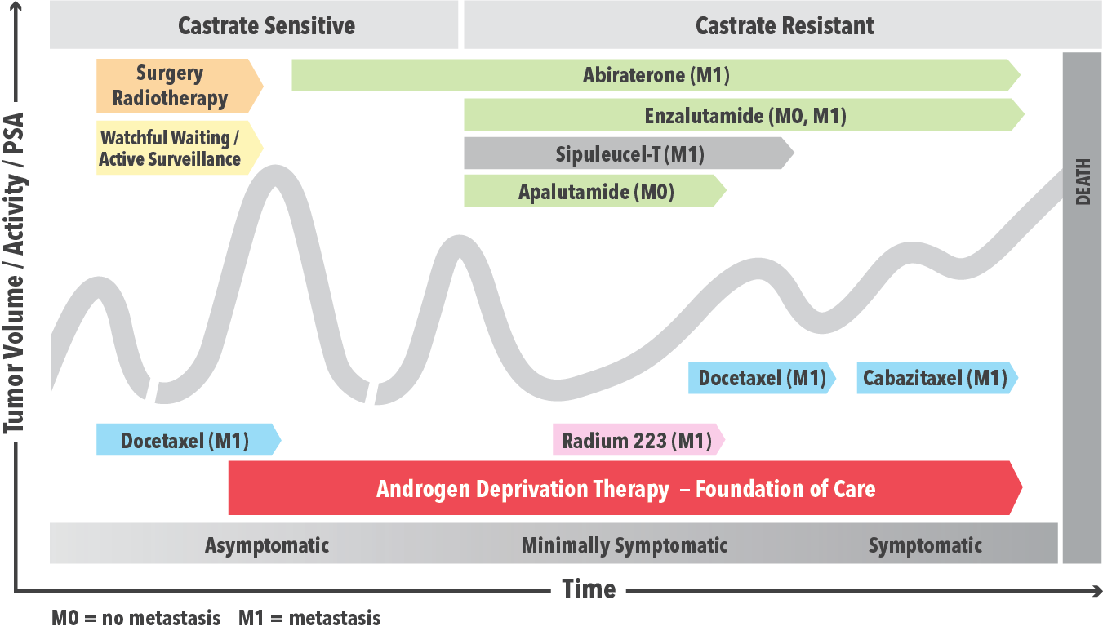
RADAR I: IMAGING NEEDS
Crawford D., Stone N., Yu E., et al. Challenges and Recommendations for Early Identification of Metastatic Disease in Prostate Cancer. Urology. 2014; Jan 8
Notes:
In this slide, you will describe how we had many different novel treatments prior to RADAR I, but there was no information on how to apply the imaging to the equation. There weren't clear guidelines with regards to how you image M1patients. With the development of several new therapies for M1 CRPC patients, and their relative survival outcomes, the need for something like this was very clear.

Slide 6
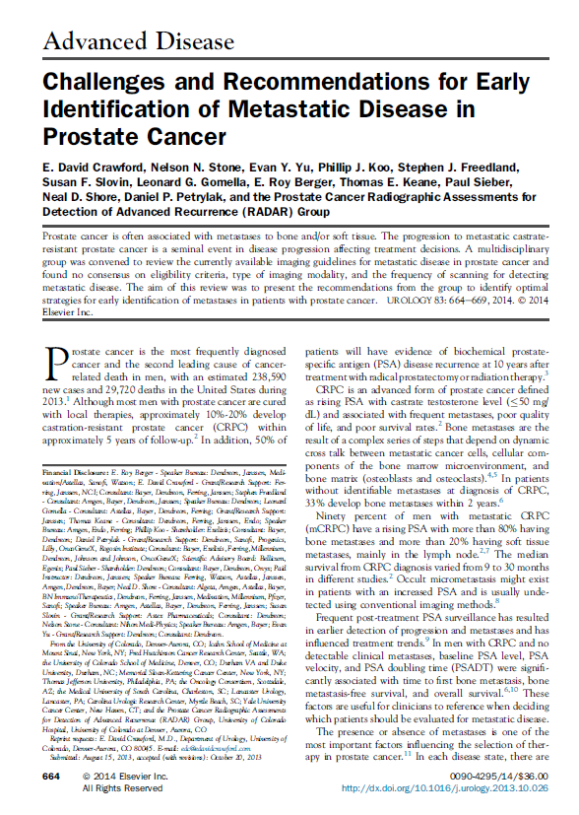
RADAR I
Contributing Authors:
E. David Crawford
Nelson N. Stone
Evan Y. Yu
Phillip J. Koo
Stephen J. Freedland
Susan F. Slovin
Leonard G. Gomella
E. Roy Berger
Thomas E. Keane
Paul Sieber
Neal D. Shore
Daniel P. Petrylak
UROLOGY 83: 664-669, 2014
Notes:
Bring it down to blue area

Slide 7
RADAR I: OVERVIEW
Prostate Cancer Radiographic Assessments for Detection of Advanced Recurrence (RADAR) Group
Reviewed the currently available imaging guidelines and relevant clinical validation studies for metastatic disease in prostate cancer
Found no consensus on eligibility criteria, type of imaging modality, or the frequency of scanning for detecting metastatic disease
Developed consensus and recommendations among the group for clinical practice to improve the early detection of metastatic disease
Summarized the discussions and conclusions from the meeting into a review article, which was accepted by Urology for publication

Slide 8
RADAR I:
GUIDELINE RECOMMENDATIONS REVIEWED
Prostate Cancer Clinical Trials Working Group 2 (2007)
American College of Radiology (2010)
European Society for Clinical Oncology (2010)
American Urological Association (2007, updated 2011)
European Association of Urology (2012)
National Comprehensive Cancer Network (2013)

Slide 9
RADAR I: IMAGING TRIGGERS
Newly diagnosed
patients
Scan high-risk patient and intermediate-risk patient with at least 2 of the following criteria positive:
1. PSA level >10 ng/m
2. Gleason Score >7
3. Palpable Disease (≥T2b)
GOAL: EARLY
IDENTIFICATION OF
METASTATIC DISEASE
Biochemical recurrent
patients
1. 1st scan when PSA level between 5 and 10ng/mL
2. Imaging frequency if negative for previous scan: 2nd scanning when PSA=20 ng/mL and every doubling of PSA level thereafter (based on PSA testing every 3 months)
M0 Castrate-
Resistant Patients
1. 1st scan when PSA level ≥2 ng/mL
2. Imaging frequency if negative for previous scan: 2nd scanning when PSA =5 ng/ml and every doubling of PSA level thereafter (based on PSA testing every 3 months)
*Guidelines should allow for physicians’clinical judgment when metastatic patients are suspected of having disease

Slide 10
RADAR I: IMAGING MODALITIES
Imaging for initial scanning:
^{99m}Tc bone scintigraphy
Abdomen/pelvis/chest CT
Additional tests to be conducted at the physician’s discretion when
necessary:
Plain radiography
MRI
NaF PET
Notes:
In this slide, you will describe how during RADAR I, we had many different novel treatments, but there was really no information on how to apply the imaging to the equation.

Slide 11
RADAR I: SUMMARY
- There is inconsistency in the literature and current practice guidelines in terms of
eligibility criteria, type of imaging modality, and the frequency of scanning for
advanced PC patients
As a result, there is underdiagnosis of metastatic disease
- Consensus and recommendations to promote early identification of metastatic
disease were developed by the RADAR I group
The objective was to improve patient management and facilitate appropriate
treatment practices
- Early detection of metastases in prostate cancer is important for optimal patient
management
Notes:
In this slide, you will describe how during RADAR I, we had many different novel treatments, but there was really no information on how to apply the imaging to the equation.

Slide 13
RADAR II:
Contributing Authors:
E. David Crawford
Leonard G. Gomella
Joe M. O’Sullivan
Bertrand Tombal
Raoul Concepcion
Paul Siber
Nelson N. Stone
Steven E. Finkelstein
Evan Y. Yu
Daniel P. Petrylak
Neal D. Shore
Fred Saad
Susan F. Slovin
Nicholas J. Vogelzang
Thomas E. Keane
Phillip J. Koo
J. Urol 2017; 104

Slide 14
RADAR II: WORKING GROUP OBJECTIVES
GOAL:
To provide a consensus on:
1. Sequencing
2. Combination
3.“Therapeutic layering”

Slide 15
RADAR II: DEFINITIONS
COMBINATION THERAPY
≥2 therapies initiated simultaneously
The backbone of oncology for some time ^{1,2,3}
THERAPUTIC LAYERING (per Working Group)
Not the same as combination therapy
≥1 agent added to an existing therapy
In CRPC, Tx is technically layering since agents are
added to ADT
1. Shannon C., Smith I. Crit Rev Oncol Hematol. 2003;45(1):77-90. 2. Maithel S.K., D'Angelica M.I. Surg Oncol Clin N Am. 2010;19(1):163-181. 3. Koupparis A., Gleave M.E. Curr Oncol. 2010;17(suppl 2): S33–S37.
Notes:
In CRPC, all treatment interventions are technically layering of therapy, as agents are added to the foundation of ADT

Slide 16
RADAR II: PERTINENT QUESTIONS
BY GROUP
DISEASE PROGRESSION
Group needed definition
Assessment of therapeutic agents/activity during treatment
THERAPY INITIATION AND DISCONTINUATION
Initiation in CRPC?
Which agent(s) for early metastases?
When is therapy/intervention changed?
Continuing therapy past progression?
Timing of treatment initiation and termination of each therapeutic agent
Can 2nd generation androgen pathway inhibitors (APIs) be used sequentially?

Slide 17
RADAR II: TREATMENT LANDSCAPE
LACK OF GUIDANCE
Guidance at the time (for treatment of CRPC)
NCCN: No guidance on order of sequence or combination of therapy
ASCO: No guidance on order of sequence or combination of therapy
AUA: No guidance on order of sequence or combination of therapy
ESMO: No guidance on order of sequence or combination of therapy
CUA-CUOG: No guidance on order of sequence or combination of therapy
This created a need to develop proper guidelines

Slide 18
RADAR II: THERAPUTIC LAYERING
Working Group Recommendations:
Therapeutic layering using ADT or
second generation androgen pathway
inhibitors in combination with new
agents in men with CRPC
Best Supportive Care
ADT
(Foundation)
2nd gen. androgen pathway inhibitors
Layering {
Immunotherapy*
Targeted alpha therapy*
Chemotherapy
Asymptomatic mCRPC
Symptomatic mCRPC
First Symptoms, Regular opioids
ªClinicalTrials.gov Identifiers: NCT01487863, NCT01981122, NCT02034
552, NCT02288247, and NCT02522715.
*Not eligible if visceral metastasis is present.
Notes:
Symptomatic mCRPC
First Symptoms Regular opioids

Slide 19
RADAR II:
BASIS OF RECOMMENDATIONS IN mCRPC
Efficacy of agent combination
Small scale studies
Potential benefit of agent combination in patients with mCRPC
Larger scale studies were still ongoing
Working Group attempted to determine:
Optimal timing
Sequence of therapy
Combination of agents

Slide 20
RADAR II:
BASIS OF RECOMMENDATIONS in mCRPC
API
Easiest agent to layer with ongoing trials to chemotherapy
Radium-223
Concurrent administration of radium-223 and 2nd generation API appears to be well-tolerated (toxicities no greater than radium-223 alone).
Longer OS with radium-223 + abiraterone (currently not recommended concomitant combination)
Longer OS with radium-223 and denosumab
Ongoing trials of radium-223 + ABBY or ENZA
Sipuleucel-T
Sipuleucel-T + ABBY + prednisone = survival benefit (no immunologic altering effects)
Sipuleucel-T + ENZA and Sipuleucel-T + radium-223 also being studied
API: Androgen Pathway Inhibitors

Slide 21
RADAR II: GOAL SUMMARY
Efficacy of agent combination
Small scale studies
Potential benefit of agent combination in patients with mCRPC
Larger scale studies were still ongoing
Working Group attempted to determine:
Optimal timing
Sequence of therapy
Combination of agents

Slide 22
RADAR II:
FINAL RECOMMENDATIONS
Immunotherapy
(sipuleucel-T)
Androgen Pathway
Inhibitors
Targeted alpha therapy
Chemotherapy
Newly diagnosed
asymptomatic/
minimally symptomatic mCRPC
Consideration after
sipuleucel-T
(biochemical/clinical
progression)
Initiated on first
sign of progression
after API
Initiated after
ABBY or ENZA and after radium-223
Initiated/added with
consecutive PSA rise
Low tumor burden
Symptomatic bone metastases
Notes:
API was defined earlier as androgen pathway inhibitor
On this slide you must click through all 4 recommendations before advancing to the next slide. I can make it automatic like the other slides if you prefer as well!

Slide 23
RADAR II: CONCLUSIONS
mCRPC Management- remains challenging despite advancements in therapy
mCRPC- best managed with different agents
Unique and complimentary mechanism of action (avoid cross-resistance)
Optimal Treatment
May depend on molecular character/genotype and patient’s clinical characteristics
Clinical Trials
Remain integral
Provide evidence of efficacy, safety and tolerability of combo regimens/patient
identification
Basis of Recommendations from RADAR II
Trial Literature
Real world experience
Optimal patient care: still depends on clinical judgement of treating physician

Slide 24
Next Generation Imaging (NGI*)
*© 2018 RADAR III

Slide 25
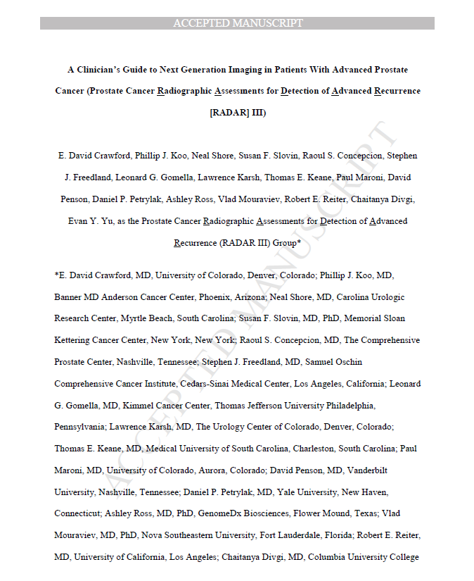
RADAR III:
Contributing Authors:
E. David Crawford
Thomas E. Keane
Paul Maroni
David Penson
Daniel P. Petrylak
Ashley Ross
Vlad Mouraviev
Robert E. Reiter
Chaitanya Divgi
Evan Y. Yu
Phillip J. Koo
Neal D. Shore
Susan F. Slovin
Raoul Concepcion
Stephen J. Freedland
Leonard G. Gomella
Lawrence Karsh
J Urol. 2018 Aug 2.

Slide 26
RADAR III: GOALS
Novel Imaging Modalities
Understand potential use:
For initial staging of patients with biochemically recurrent M0
(nmCRPC) or M1 prostate cancer
Men with CRPC
Understand Rationale
Obtaining these scans
Frequency of ordering
Understanding the integration of results into clinical
decision making algorithms
Notes:
Most importantly: Understanding the integration of results into clinical decision making algorithms (this must be emphasized)

Slide 27
RADAR III: GOALS (CON’T)
Gauge utilization of novel imaging modalities
amongst managing physicians
How fast/easy to implement into one’s practice?
Does practice setting impact timing of adherence?
Redefine terminology
Does not accurately represent current treatment landscape
Biochemically recurrent, M0 or M1
Update existing RADAR I and II recommendations
based on recent data

Slide 28
RADAR III: RADIOPHARMACEUTICALS
¹⁸F-FACBC
(fluciclovine)
Sensitivity:
89-100%
Specificity: 67-70%
Action: Amino Acid Transport
Indications: Local and Distant recurrence
¹¹C-choline
Sensitivity:
38-98%
Specificity:
50-100%
Action: Cell membrane synthesis
Indications: Detection of recurrent disease in lymph node and soft tissues
⁶⁸Ga-PSMA
Sensitivity: 63-86%
Specificity:
95-100%
Action: Targets PSMA
Indications:
High detection of local/distant sites of recurrence; metastatic disease in high risk patients
¹⁸F-DCFBC
Sensitivity:
92%
Specificity:
88%
Action: Targets PSMA
Indications: Better selection of primary definitive therapy, hormone sensitive and CRPC
¹⁸F-DCFPyL
Sensitivity:
71%
Specificity:
89%
Action:
Binds PSMA
Indications: Detection of occult lymph nodes before primary treatment; early local and distant recurrence
¹¹C-acetate
Sensitivity: 42-90%
Specificity: 62-96%
Action: Lipid Synthesis
Indications: Identification of metastatic disease
Notes:
These are the important radiopharmaceuticals being discussed during development of RADAR III

Slide 29
RADAR III: STUDIES EVALUATED
Studies evaluated for RADAR III
Almost all were of patients with biochemical recurrence (BCR)
Research focused on:
Choline
PSMA
Fluciclovine
BCR is where data is most mature
Data shows these tools are far superior to tools used in the past (Tc bone scan/CT/PET).

Slide 30
RADAR III: INSURANCE COVERAGE
Scan Type
Medicare Coverage
¹⁸F-fluciclovine PET/CT
¹¹C- choline PET/CT
¹⁸F-NaF PET/CT
¹⁸F-FDG PET/CT
⁶⁸Ga-PSMA PET/CT
Yes
Yes (Limited*)
No
Yes (STS)
No
*On-site cyclotron with site specific abbreviated new drug application
STS, subsequent treatment strategy
Notes:
This is really just to discuss the current coverage available for some of these new NGIs so docs know what to order

Slide 31
RADAR III: TIME FOR A CHANGE IN TERMINOLOGY:
ENDOCRINE RESISTANT (ERPC)
NOT CASTRATE RESISTANT PROSTATE CANCER (CRPC)
ERPC not CRPC per the Working Group
Rationale suggested before in the past
RADAR III guidelines include:
Men with PSA/other progression post adequate ADT
Any stage of PC: Label them as ERPC
Patient label: nmERPC
Men with progression post ADT
Negative conventional imaging (CI)
Should be labeled nmERPC
Patient label: nmERPC*
Men with progression post ADT
Negative NGI
Should be labeled as *nmERPC
mERPC: Positive METS via CI
mERPC*: Positive METS via NGI
Notes:
There are a few clicks developed into this slide. What I want you to emphasize is the naming
conventions in each area. You say nmERPC when conventional imaging fails to identify metastases
and “click” conversely mERPC is when CI identifies positive METS (next section will be nmERPC* and mERPC* (after the click)

Slide 32
RADAR III: RECOMMENDATIONS
Conventional imaging, followed by NGI if:
CI is equivocal or negative
Clinician still suspects progression based on the following
criteria:
Gleason Score
PSA level
PSA velocity in untreated patients
Patients meeting NCCN, very high risk or locally
advanced/N1 disease
Should be considered for NGI at initial diagnosis
Notes:
CI= conventional imaging

Slide 33
RADAR III: RECOMMENDATIONS
RADAR I
RADAR III
Scan high-risk patient and
intermediate-risk patient with
at least 2 of the following criteria:
1. PSA level >10 ng/mL
2. Gleason Score >7
3. Palpable Disease (≥T2b)
IF CI is equivocal or negative with continued high suspicion for metastatic disease, consider NGI
Newly diagnosed patients
GOAL
EARLY
IDENTIFICATION OF METASTATIC DISEASE
1. 1st scan when PSA level between 5 and 10 ng/mL
2. Imaging frequency if
negative for previous scan:
2nd scanning when PSA=20 ng/mL
and every doubling of PSA level
thereafter (based on PSA testing every 3 months
Consider NGI for PSA ≥0.5
PSA <0.5 can be considered based
on specific performance of various
NGI techniques
biochemically recurrent patients
1. 1st scan when PSA level ≥2 ng/mL
2. Imaging frequency if negative for previous scan: 2nd scanning when PSA =5 ng/ml and every doubling of PSA level thereafter (based on PSA testing every 3 months)
Only Consider NGI
in the setting of
PSADT <6 months, when M1 therapies
would be
appropriate
M0 Castrate- resistant patients
Utilize conventional imaging (CI), consider NGI only if
CI are negative and clinician suspects disease progression
NGI based on at least one of the following:
1. Doubling of PSA since last image
2. Every 6-9 months in the absence of PSA rise
3. Change in symptomatology
4. Change in performance status
M1

Slide 34
CASE STUDY

Slide 35
RADAR III: CASE STUDY
82 year old male in good health
History
70 years old at diagnosis
PSA at diagnosis: 28 ng/mL
Initial Gleason score: 9
Initial clinical staging: T2
Treated RRP + 6-month ADT
Notes:
Overall this case is a nice representation of how traditional scans may not be accurate enough to diagnose locally recurrent prostate cancer (axumin scan is obviously superior). It also shows how a conventional biopsy is insufficient (missed the area of cancer)

Slide 36
RADAR III: CASE STUDY
PSA History
PSA went from undetectable for 9 years to 3.5 ng/mL at year
12 post-treatment
Imaging
Conventional imaging was negative (bone scan/CT scan)
Fluciclovine scan positive, right mesorectal fasica
Treatment
SBRT without ADT
4 months post-op, PSA was undetectable at <0.01 ng/mL
PSA remains undetectable, patient is being observed
Notes:
Fluciclovine scan positive, right mesorectal fasica
Treated with SBRT, no ADT and 4 months later PSA <0.01 ng/mL

Slide 37
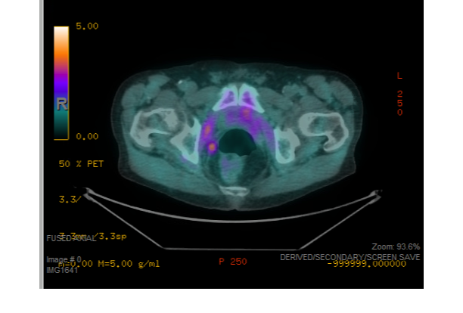
RADAR III: CASE STUDY
NGI- Fluciclovine PET/CT
Increased uptake in small nodule right mesorectal fascia consistent with metastasis.
Radiation fields for SBRT 600 with cGy per fraction for 5 fractions. Total of 3000 cGy

Slide 38
RADAR III CONCLUSIONS AND OVERALL CONCLUSIONS

Slide 39
RADAR III: CONCLUSIONS
CI: Continue to have role in diagnosis
NGI: More sensitive in visualizing aPC
If early, aggressive intervention is indicated
¹⁸F-fluciclovine PET (recommended NGI)
Best availability, sensitivity and specificity (in USA)
PSMA PET/CT
Show potential
Availability in US is highly limited

Slide 40
RADAR III: CONCLUSIONS (con’t)
Strong recommendation for NGI use
Patients with BCR
Data is most robust on use of NGIs
Likelihood of site directed therapy is greatest for these patients
Limitations
Working Group recognizes lack of efficacy/safety data
Benefits
Despite limitations, consensus manuscript still reached goals
To provide guidance in an area where clinical decision-making is less than certain
Greatest potential impact
Alter therapy/improve patient outcomes with NGIs
This is where reintroduction of local therapy +/- systemic therapy has greatest potential
Notes:
This slide each section you must click to get access to the next part. This is so you can discuss what you have to say and it’s more
Emphasized for the viewer.

Slide 41
RADAR I, II and III: CONCLUSIONS
Overall Goals
Improve patient survival
Reduce late stage diagnoses
Develop standardized criteria for imaging and
various types of treatment
Improve and generalize knowledge amongst
urologic oncologists and medical oncologists.

Slide 42
QUESTIONS?

Slide 43
BACKUP CASE STUDY

Slide 44
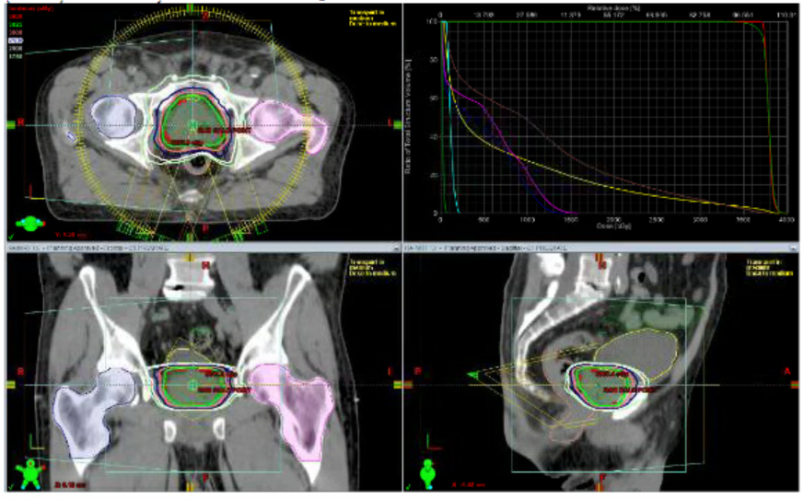
RADAR III: CASE STUDY
01/2011: TRUS biopsy shows GS 3+4=7 in 1/12cores, left sided.
Patient drops out of AS
received SBRT without ADT 5/2013
3625cGy in 5 fractions
PSA NADIR .55 11/2014
Notes:
Interesting how the patient dropped out of AS, not because of any evidence of progression but likely due to worry/anxiety

Slide 45
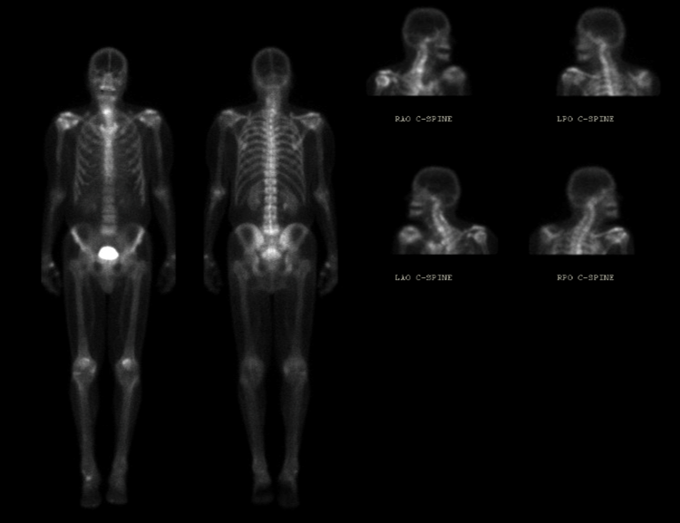
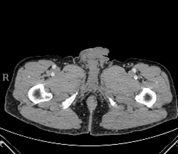
Conventional Imaging: Bone and CT Scans
Pelvic CT shows absence of prostate and no other abnormalities
Bone scan negative for metastasis

Slide 46
RADAR III: CASE STUDY
PSA: Steady rise over time
5/2016: 1.5 ng/mL
2/2017: 2.48 ng/mL
6/2017: 3.40 ng/mL
3/2018: 4.83ng/mL
9/2018: 6.81ng/mL
PSA DT: 8 months
TRUS biopsy 6/2018 was negative
Patient elected not to undergo any adjuvant therapy despite Phoenix Criteria failure.
Notes:
Note the PSA DT is based on the two dates highlighted as was mentioned in the notes of the patient
Focus of HGPIN in 1 out of 12 cores on the left base

Slide 47
RADAR III: CASE STUDY
CT 9/2017
1.2 cm enhancing area in the left posterior aspect of the mid prostate gland
Cannot be further characterized on examination
Bone Scan 9/2017
No scintigraphic evidence of osseous metastatic disease.
Notes:
CI: CT was not sensitive enough to pick up any evidence of metastases.

Slide 48
RADAR III: ARS QUESTION
What would you do now? Select all that apply:
Axumin scan
3d mapping biopsy of the prostate
ConfirmMDx
Salvage cryotherapy
ADT
ADT+ therapeutic layering
Monitor PSA
Notes:
Slide is HIDDEN. This is an optional question that can be modified/deleted if you would like

Slide 49
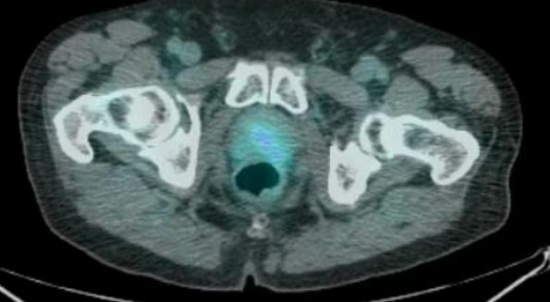
RADAR III: CASE STUDY
Axumin scan results:
Notes:
In this slide when you click, you will be able to see the white circle go over the area of suspicion

Slide 50
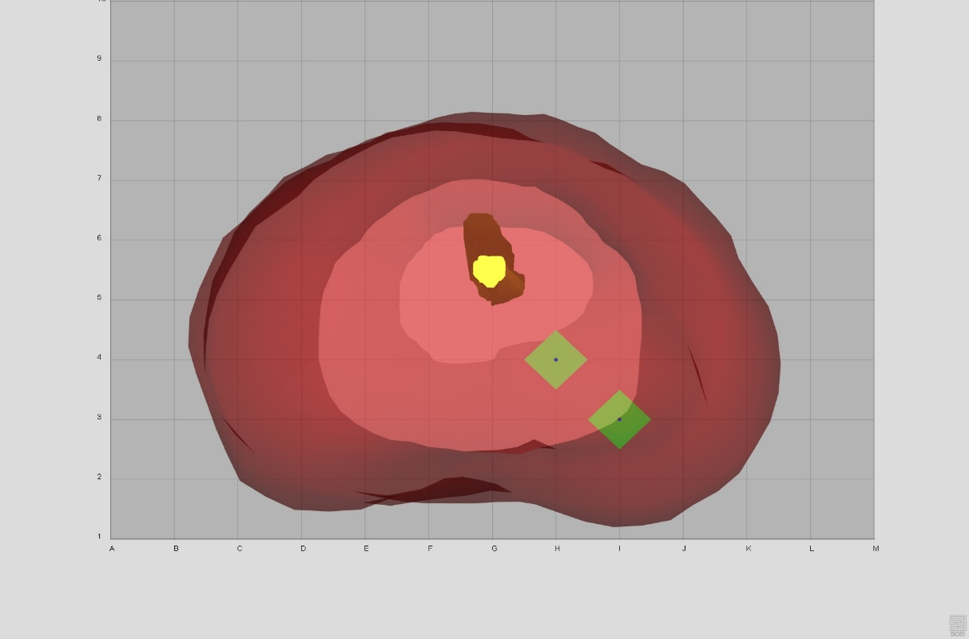
RADAR III: CASE STUDY
3D staging biopsy (combined with salvage cryo) results:
Gleason 4+4=8 in 2 cores on the left
Notes:
Patient had 3d mapping biopsy of the peripheral zone and lower transition zone followed immediately by salvage cryotherapy
In this slide you will be like “you can see here where the cancer was on the Axumin scan and now you can see that on the mapping biopsy, we essentially
Confirmed that there was a focus of two Gleason 4+4=8 prostate cancers. Also, it’s not the best case for RADAR since he’s not ERPC or CRPC (as far as we know since he didn’t do ADT) but it has great visualizations.

Slide 51
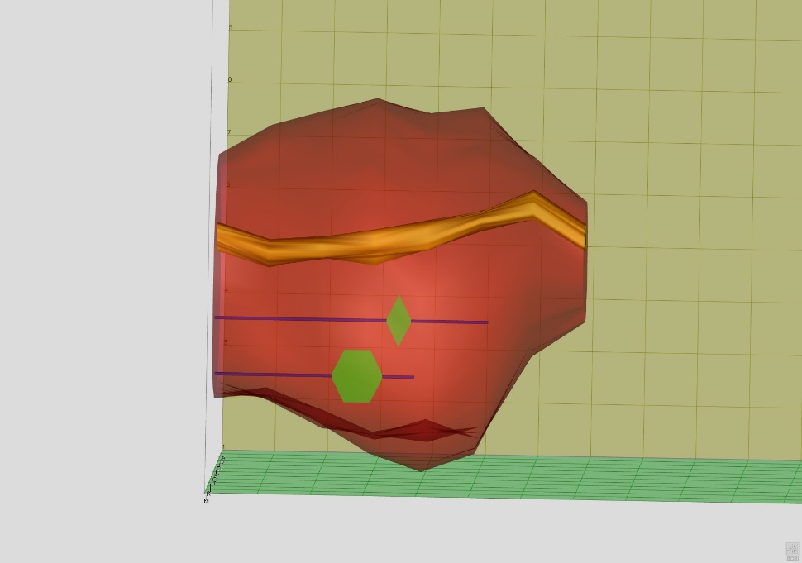
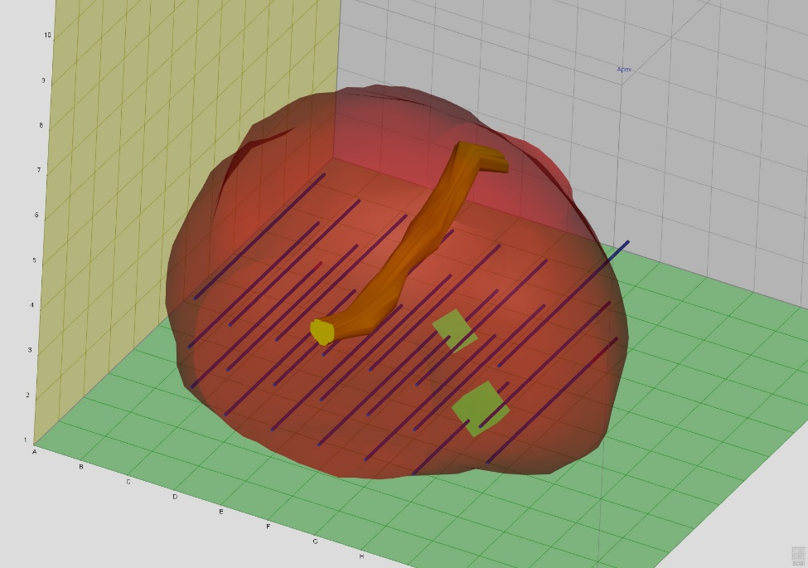
3D mapping biopsy additional images
Notes:
Slide is hidden this is just additional mapping biopsy images

