Slide 1
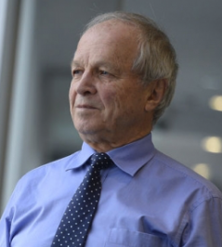
Androgen Receptor Targeted Treatments of Prostate Cancer:
35 Years of Progress with Antiandrogens
Fernand Labrie, OC OQ MSRC
1937-2019
E. David Crawford, Paul F. Schellhammer, David G. McLeod, Judd W. Moul,
Celestia S. Higano, Neal Shore, Louis Denis, Peter Iversen, Mario A. Eisenberger
and Fernand Labrie

Slide 2


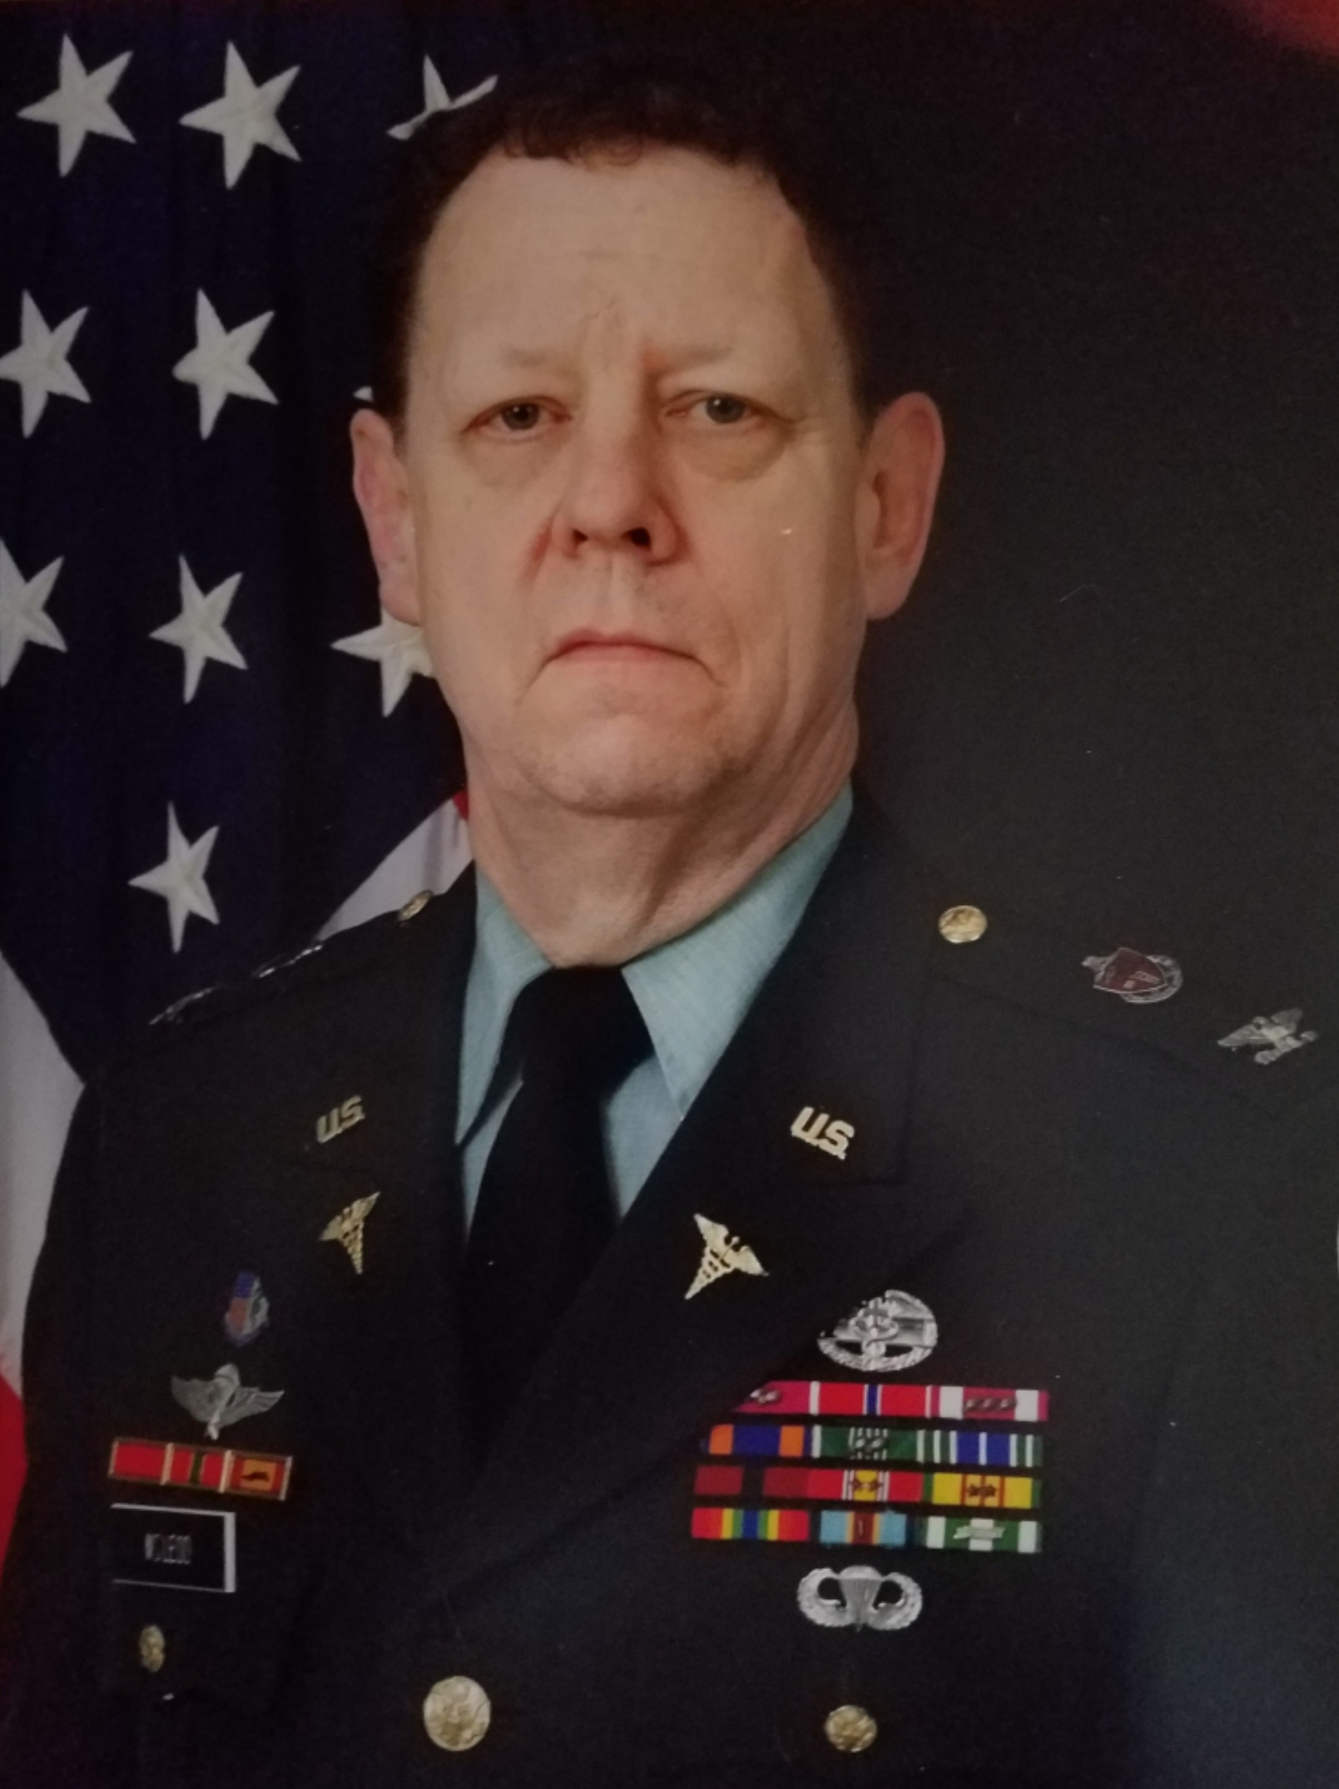
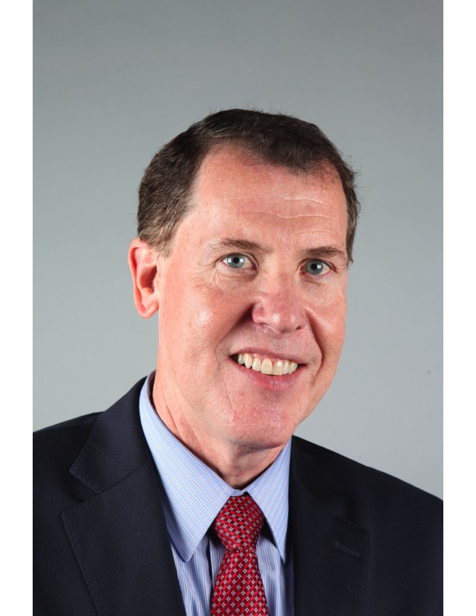


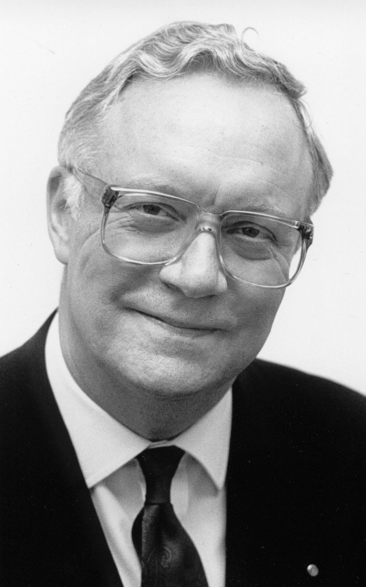
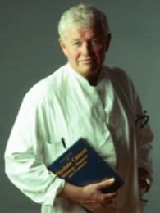

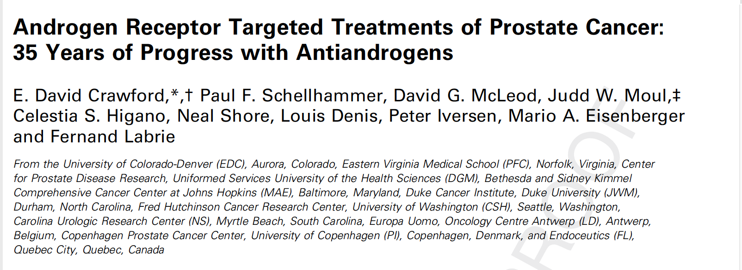

J Urol. 2018 Nov;200(5):956-966

Slide 3
“The term antiandrogen is used to describe a class of
agents which compete with the binding of circulating or
locally derived androgens to the AR. Antiandrogens
are globally classified as steroidal or nonsteroidal.
They differ in chemical structure, pharmacological
effects and safety profiles.”
Crawford et al

Slide 4
PRESENTATION OBJECTIVES
1. Understand the development of antiandrogens (AAs)
2. How AAs have played a role in prostate cancer over the past 35 years
3. How the androgen receptor influences drug development
4. How AAs continue to play a role in prostate cancer management
5. What are the future therapeutic options in prostate cancer

Slide 5
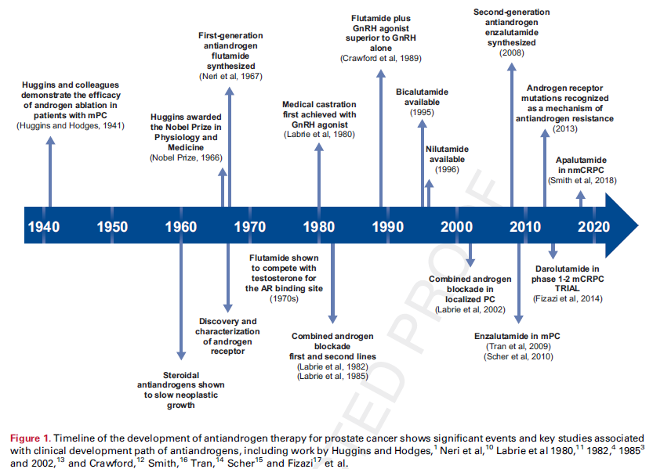
Significant Events and Studies that led to the Development Path of Antiandrogens (AA)
Dr. E David Crawford
Notes:
HUGGINS and Hodges found that lowering circulating androgen levels by surgical castration or estrogen therapy could palliate symptoms of advanced PC.
In this section, describe how the AR was first discovered and characterized at three laboratories in the 1960s. You need to reproduce the entire figure one with all the antiandrogens after flutamide

Slide 6
ANTIANDROGENS (AA):
Steroidal
Preceded nonsteroidal
Competitively blocked DHT and testosterone(AA) but also progestational effects (estrogen-like)
Early steroidal AA
  Cyproterone Acetate
  Medroxyprogesterone acetate
Undesirable side effects (estrogen component)
Seldom used to treat PC
Nonsteroidal
Developed in late 1960s/early 1970s
Targeted only the androgen receptor (AR)^{1,2}
Lacked progestational effects of CPA and MP^{1,2}
Safer than steroidal
Dr. Schellhammer
Notes:
D'Amico AV, Denham JW, Crook J et al: Influence of androgen suppression therapy for prostate cancer on the frequency and timing of fatal myocardial infarctions. J Clin Oncol 2007; 25: 2420-5.
Shipley WU, Seiferheld W, Lukka HR et al: Radiation with or without antiandrogen therapy in recurrent prostate cancer. N Engl J Med 2017; 376: 417-28.

Slide 7
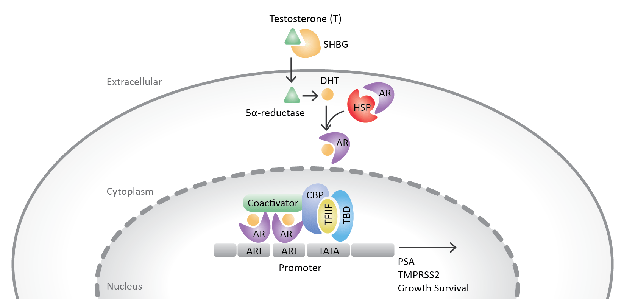
Androgen and AR Action
Dr. David McCloud
Notes:
SOURCE: modified from Nature Publishing Group https://www.nature.com/articles/ncpuro0604/figures/4

Slide 8
Antiandrogen Monotherapy
Dr. Judd Moul
Antiandrogen
AA
Androgen Receptor
AA
AA
AA
— Testosterone
— Dihydrotestosterone
— Antiandrogen
— Androgen Receptor
DHT
T
AA
DHT
AA
DHT
Nucleus
AA
AA
T
T
DHT
AA
DHT
SOURCE: Dr. ED Crawford
Notes:
SOURCE: Dr. ED Crawford

Slide 9
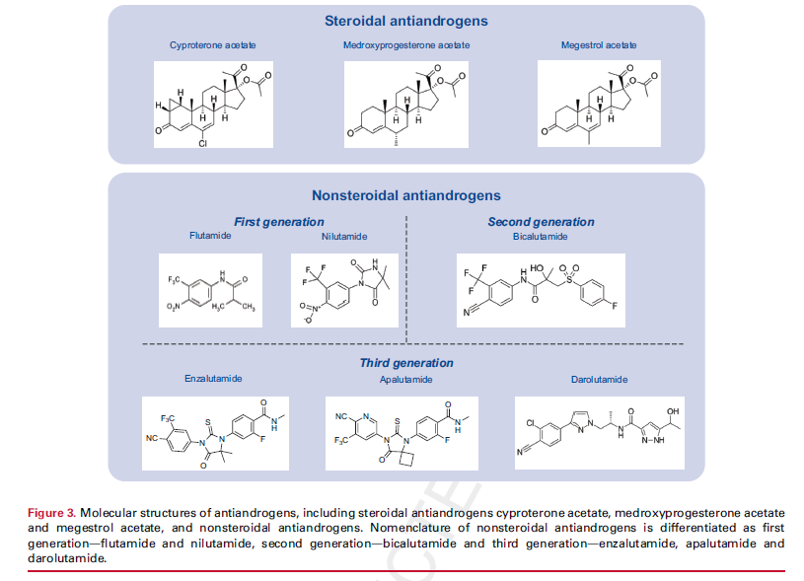
Dr. Tia Higano

Slide 10
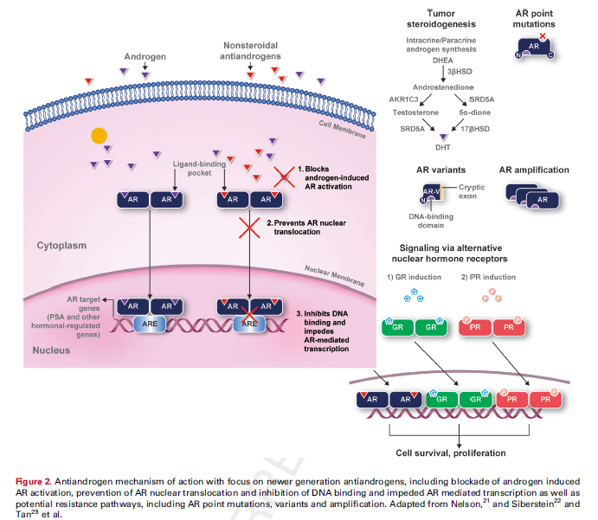
Dr. Shore

Slide 11

First
Generation
Dr. Denis
Non-steroidal anti-androgens

Slide 12
First Generation Non-Steroidal AA
Dr. Peter Iversen
Flutamide and Nilutamide
  Effective but weak affinity for AR
  Can lead to agonist activity over time
  Multiple trials show that in combination with LHRH agonists modestly improve survival

Slide 13
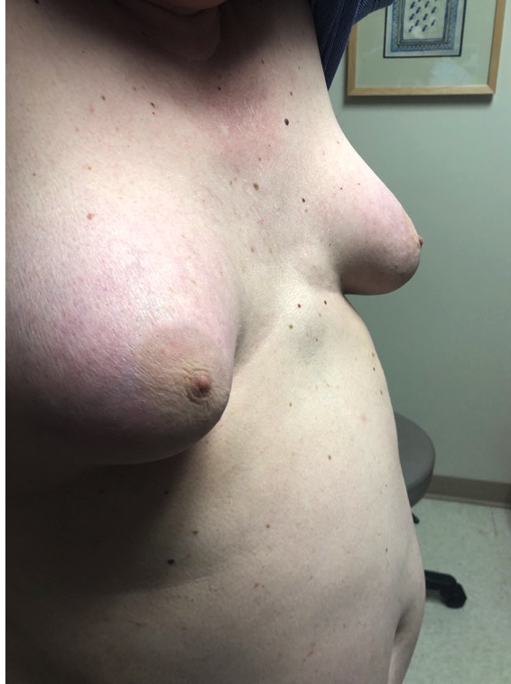
Side Effects of Anti-Androgen Monotherapy
Gynecomastia
Flutamide
  Diarrhea, hepatotoxicity (some fatal)
Nilutamide
  Nausea, dark light accommodation, alcohol intolerance, hepatotoxicity
Bicalutamide
  Nausea, diarrhea, constipation, hepatotoxicity
Notes:
Photos from Dr. ED Crawford
USPIs for Flutamide, Nilutamide, Bicalutamide

Slide 14
First Generation Non-Steroidal AA
Dr. Eisenberger
Flutamide
  Investigated by Neri et. al in 1967 as bacteriostatic agent¹
  Half-life of 6-8 hrs
  Pre-PSA era shown to be safe^{2,3,4,5,6}
  Led to concept of combined androgen blockade⁷
  Combined with Leuprolide, increased overall median survival to 36 mo. / 28 mo., leading to FDA approval in 1989⁸
  Increased overall survival 3-6 mo.^{9,10,11}
Notes:
1. Neri R: Pharmacology and pharmacokinetics of flutamide. Urology 1989; 34: 19.
2. Labrie F, Dupont A and Belanger A: Complete androgen blockade for the treatment of prostate cancer. In: Important Advances in Oncology 1985. Edited by VT DeVita Jr, S Hellman and SA Rosenberg. Philadelphia: Lippincott Williams & Wilkins 1985; pp 193e217.
3. Labrie F, Dupont A, Belanger A et al: New hormonal therapy in prostatic carcinoma: combined treatment with an LHRH agonist and an antiandrogen. Clin Invest Med 1982; 5: 267.
4. Labrie F, Dupont A, Belanger A et al: New approach in the treatment of prostate cancer: complete instead of partial withdrawal of androgens. Prostate 1983; 4: 579.
Tombal B and van Soest RJ: Prostate cancer: STAMPEDE, LATITUDE and Fernand Labrie’s legacy. Nat Rev Urol 2017; 14: 588.
Stoliar B and Albert DJ: SCH 13521 in the treatment of advanced carcinoma of the prostate. J Urol 1974; 111: 803.
7. ATLAS (NCT02531516), ACIS (NCT02257736), TITAN (NCT02489318, ARASENS (NCT02799602), EMBARK (NCT02319837), ARCHES (NCT02677896), PEACE III (NCT02194842)
Crawford ED, Eisenberger MA, McLeod DG et al: A controlled trial of leuprolide with and without flutamide in prostatic carcinoma. N Engl J Med 1989; 321: 419.
Caubet: NSAA (3732), Caubet: NSAA (1978) and Caubet: NSAA (2357), Caubet JF: Urology 1997
Debruyne: nilutamide, Debruyne FM: Eur Urol, suppl, 1996
11. Bennett: flutamide, Bennett CL: Prostate Cancer Prostatic Dis 1999

Slide 15
First Generation Non-Steroidal AA
Dr. E David Crawford
Nilutamide
  Half life of ~2 days, allowing for once-daily dosing after 2 weeks
  FDA approval in 1996 after trial showed improved median time to death & progression¹
  AEs include: delayed adaptation to darkness (27-33%), alcohol intolerance (6-19%)^{2,3} interstitial pneumonitis (1%)⁴, elevated liver enzymes (8%)¹
  Also related to hot flashes, breast pain & gynecomastia^{1,2,5,6}
Notes:
Scher HI, Fizazi K, Saad F et al: Increased survival with enzalutamide in prostate cancer after chemotherapy. N Engl J Med 2012; 367: 1187-97.
Boccardo F, Decensi AU, Guarneri D et al: Anandron (RU 23908) in metastatic prostate cancer: preliminary results of a multicentric Italian study. Cancer Detect Prev 1991; 15: 501.
Decensi AU, Boccardo F, Guarneri D et al: Monotherapy with nilutamide, a pure nonsteroidal antiandrogen, in untreated patients with metastatic carcinoma of the prostate. The Italian Prostatic Cancer Project. J Urol 1991; 146: 377.
Beer TM, Armstrong AJ, Rathkopf DE et al: Enzalutamide in metastatic prostate cancer before chemotherapy. N Engl J Med 2014; 371: 424-33.
Shore ND, Chowdhury S, Villers A et al: Efficacy and safety of enzalutamide versus bicalutamide for patients with metastatic prostate cancer (TERRAIN): a randomised, double-blind, phase 2 study. Lancet Oncol 2016; 17: 153-63.
Penson DF, Armstrong AJ, Concepcion R et al: Enzalutamide versus bicalutamide in castration-resistant prostate cancer: the STRIVE trial. J Clin Oncol 2016; 34: 2098-106.

Slide 16
Second Generation
Dr. Schellhammer
Non-steroidal anti-androgen

Slide 17
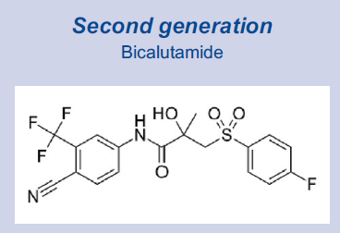
Second Generation
Non-Steroidal AA
Dr. David McCloud
Bicalutamide
  Synthesized in the 80’s, approved to treat PC in 1995
  Efficacy in the same range is flutamide and nilutamide
  Selective inhibitor
  Longer half-life than 1st generation AAs (7 days) allowing dosing once-daily
  Due to increase in estrogen from testosterone rise with monotherapy, AEs from 50mg include breast pain (76%), gynecomastia (60%), hot flashes (25%), impotence (25% to 28%) and sub-optimal PSA response¹
  In global EPC trial program, 150mg was associated with improved survival in men when combined with radiation, but poor survival when combined with watchful waiting^{2,3,4,5}
Notes:
Tombal B, Borre M, Rathenborg P et al: Long-term antitumor activity and safety of enzalutamide monotherapy in hormone naive prostate cancer: 3-year open label followup results. J Urol 2018; 199: 459-64.
Iversen P, McLeod DG, See WA et al: Antiandrogen monotherapy in patients with localized or locally advanced prostate cancer: final results from the bicalutamide Early Prostate Cancer programme at a median follow-up of 9.7 years. BJU Int 2010; 105: 1074.
Slovin S, Clark W, Carles J et al: Seizure rates in enzalutamide-treated men with metastatic castration-resistant prostate cancer and risk of seizure: the UPWARD study. JAMA Oncol 2017: 2017 Dec [Epub ahead of print].
Rathkopf DE, Morris MJ, Fox JJ et al: Phase I study of ARN-509, a novel antiandrogen, in the treatment of castration-resistant prostate cancer. J Clin Oncol 2013; 31: 3525-30.
Smith MR, Antonarakis ES, Ryan CJ et al: Phase 2 study of the safety and antitumor activity of apalutamide (ARN-509), a potent androgen receptor antagonist, in the high-risk nonmetastatic castration-resistant prostate cancer cohort. Eur Urol 2016; 70: 963-70.

Slide 18
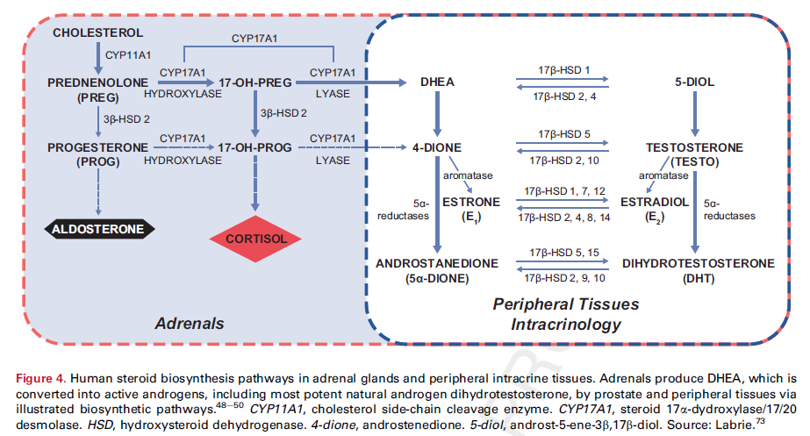
RATIONALE FOR AA INCOMBINATION WITH ADT
Dr. Judd Moul

Slide 19
Third Generation
Dr. Tia Higano
Anti-androgens

Slide 20
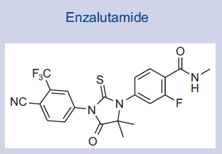
Third Generation
Anti-Androgen
Dr. Shore
Enzalutamide
  Selective antagonist
  Inhibits AR translocation to cell nucleus, recruitment of AR cofactors and AR binding to DNA
  Developed using non-steroidal agonist RU59063^{1,2}
  Five-to-eightfold higher binding affinity for the AR compared with bicalutamide
  6-day half-life³
Notes:
Tran C, Ouk S, Clegg NJ et al: Development of a second-generation antiandrogen for treatment of advanced prostate cancer. Science 2009; 324: 787.
Davies AH, Beltran H, Zoubeidi A: Cellular plasticity and the neuroendocrine phenotype in prostate cancer. Nat Rev Urol 2018.
Li N, Truong S, Nouri M et al: Non-canonical activation of hedgehog in prostate cancer cells mediated by the interaction of transcriptionally active androgen receptor proteins with Gli3. Oncogene 2018.

Slide 21
Third Generation
Anti-Androgen
Dr. Denis
Enzalutamide – clinical trials
  AFFIRM study¹ (terminated after 520 deaths)
  4.8/mo. median overall survival improvement
  PREVAIL study² (terminated early when a planned interim analysis was done after 540 deaths were reported)
  Significant survival reported vs. placebo
  Phase 2 TERRAIN study³ - Enzalutamide demonstrated greater activity than bicalutamide 50 mg daily in patients with asymptomatic or mildly symptomatic metastatic CRPC
Notes:
AFFIRM (Safety and Efficacy Study of MDV3100 in Patients With Castration-Resistant Prostate Cancer Who Have Been Previously Treated With Docetaxel-based Chemotherapy, ClinicalTrials.gov NCT00974311)
PREVAIL Study (Clinical-Trials.gov NCT03260517)
Phase 2 TERRAIN (A Study of Enzalutamide Versus Bicalutamide in Castrate Men with Metastatic Prostate Cancer, ClinicalTrials.gov NCT01288911)

Slide 22
Third Generation
Anti-Androgen
Dr. Peter Iversen
Enzalutamide – clinical trials (cont.)
  STRIVE study¹ (demonstrated increase in progression-free survival vs. bicalutamide)
  Global phase 3 EMBARK trial² (recruiting now)
  Compared leuprolide plus enzalutamide, leuprolide plus placebo and enzalutamide monotherapy in men with biochemical relapse who are at high risk for metastatic disease
  PROSPER³ (Non-metastatic castration-resistant prostate cancer) - study of patients with non-metastatic CRPC metastasis
Notes:
STRIVE (Safety and Efficacy Study of Enzalutamide versus Bicalutamide in Men with Prostate Cancer, ClinicalTrials.gov NCT01664923)
Phase 3 EMBARK (Safety and Efficacy Study of Enzalutamide Plus Leuprolide in Patients with Nonmetastatic Prostate Cancer, ClinicalTrials.gov NCT02319837)
PROSPER (Safety and Efficacy Study of Enzalutamide in Patients with Nonmetastatic Castration-Resistant Prostate Cancer)

Slide 23
Third Generation
Anti-Androgen
Dr. Eisenberger
Enzalutamide – common AEs
  Fatigue
  Hypertension
  Falls and seizures

Slide 24
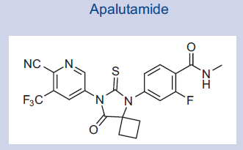
Third Generation
Anti-Androgen
Dr. E David Crawford
Apalutamide (ARN-509)
  Emerged from the same medicinal chemistry laboratory as enzalutamide, seeking more potent antiandrogens with no significant agonistic activity¹
  Greater vivo activity in xenograft models²
  Most frequent AEs were fatigue (47%) and a single case of grade 3 abdominal pain from dose limiting toxicity³
  SPARTAN trial of non-metastatic CRPC showed significantly longer metastasis-free survival for apalutamide than placebo⁴
Notes:
Davies AH, Beltran H, Zoubeidi A: Cellular plasticity and the neuroendocrine phenotype in prostate cancer. Nat Rev Urol 2018.
Silberstein JL, Taylor MN, Antonarakis ES: Novel insights into molecular indicators of response and resistance to modern androgen-axis therapies in prostate cancer. Curr Urol Rep 2016; 17: 29.
Tyrrell CJ, Kaisary AV, Iversen P et al: A randomised comparison of 'Casodex' (bicalutamide) 150 mg monotherapy versus castration in the treatment of metastatic and locally advanced prostate cancer. Eur Urol 1998; 33: 447-56.
SPARTAN (Study of Apalutamide [ARN-509] in Men With Non-Metastatic Castration-Resistant Prostate Cancer, ClinicalTrials.gov NCT01946204)

Slide 25

Apalutamide: Potential Side Effects
Fatigue
Rash
Hypertension
Hypothyroidism
Diarrhea
Nausea
Weight loss
Arthralgia
Falls and fractures
Hot flush
Decreased appetite
Peripheral edema
Seizures
Notes:
SOURCE: Janssen USPI Erleada

Slide 26
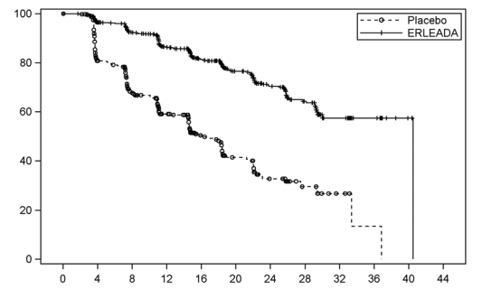
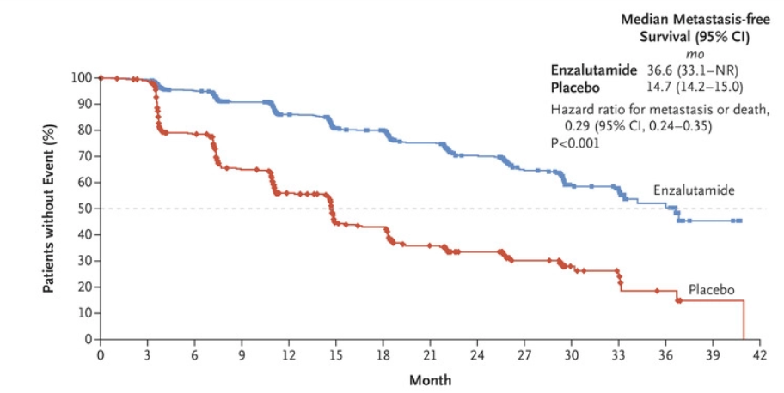
Apalutamide and Enzalutamide in nmCRPC
Dr. Schellhammer
SPARTAN Trial (apalutamide)
40.5m v 16.2m for metastasis free survival
40.5m v 16.6m to metastasis
40.5m v 14.7m progression free survival
HR 0.28
PROSPER Trial (enzalutamide)
median metastasis-free survival was 36.6m for enzalutamide v 14.7m for placebo group (HR for metastasis or death, 0.29; P<0.001
time to PSA progression (37.2m for enzalutamide v 3.9m for placebo; hazard ratio, 0.07; P<0.001; progression occurred in 22% v 69% of patients)
Metastasis-Free Probability (%)
Months from Randomization
Notes:
REFERENCE: Prosper Hussein 2018 N Engl J Med 2018; 378:2465-2474 Spartan Smith et al N Engl J Med 2018; 378:1408-1418

Slide 27
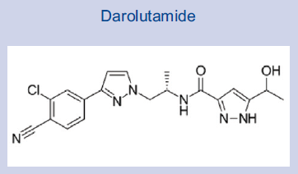
Third Generation
Anti-Androgen
Dr. David McCloud
Darolutamide
  Also third-generation
  Low penetration of the blood-brain barrier – undetectable in the brain 8 hours after dose¹
  As a single agent, does not increase testosterone in mice and binds to mutated AR²
Notes:
Reference not included (70)
Reference not included (71)

Slide 28
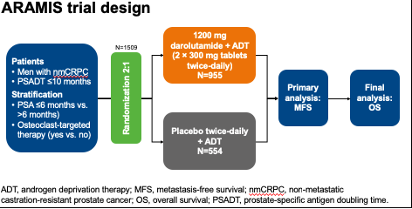
Darolutamide
Dr. Judd Moul

Slide 29
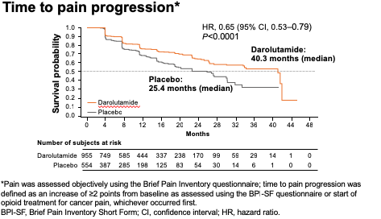
ARAMIS
Dr. Tia Higano

Slide 30
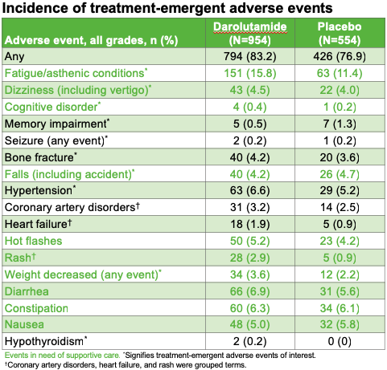
ARAMIS: Side Effects
Dr. Shore

Slide 31
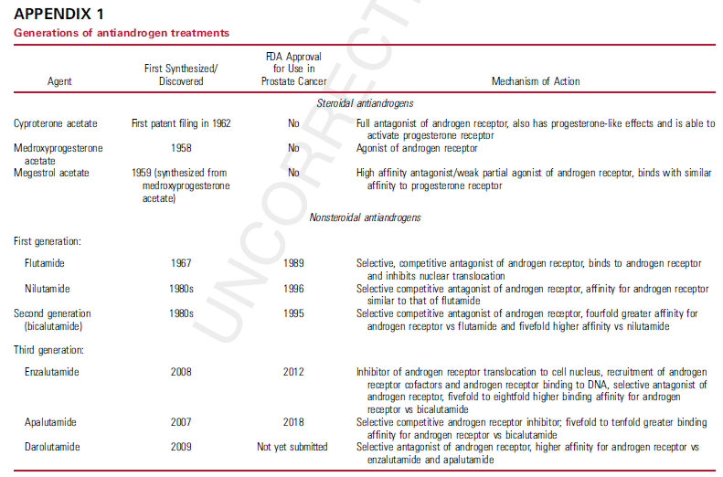
Dr. Denis

Slide 32
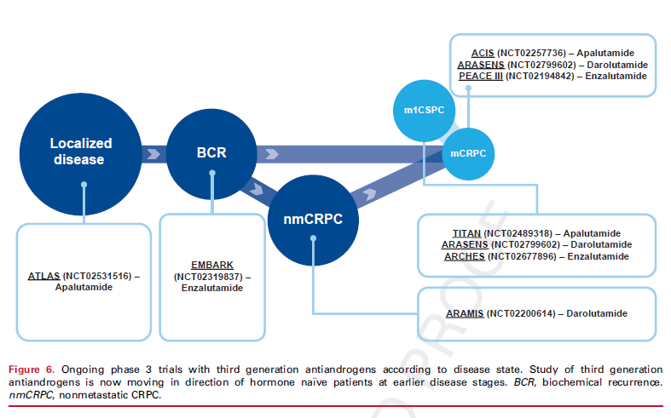
Current Clinical Trials
Dr. Peter Iversen

Slide 33
Future Therapeutic Options
Dr. Eisenberger

Slide 34
Future Therapeutic Options
Dr. E David Crawford
Greater understanding in the last decade of the mechanisms involved in intracrine & paracrine androgen production
AR over expression was established as a principal driver of CRPC and a drug screen of antiandrogens that could retain activity when AR over-expressed led to enzalutamide discovery

Slide 35
Future Therapeutic Options
Dr. Schellhammer
Several AR-dependent mechanisms recognized as CRPC-drivers, including:
  AR over-expression (with/without amplification)
  AR mutations
  AR variants
  Intra-tumor production of testosterone & DHT
  Overexpression of glucocorticoid receptor & AR loss
Drugs targeting these resistance mechanisms are in development
Administration earlier in disease stage likely to improve results

Slide 36
THANKS!
Dr. David
McCloud
Any questions?

